Slide 1
https://bit.ly/birn-data
Jonathan Soma
Columbia University
js4571@columbia.edu
@dangerscarf
AI for Reporting
tricks for the newsroom

Slide 2
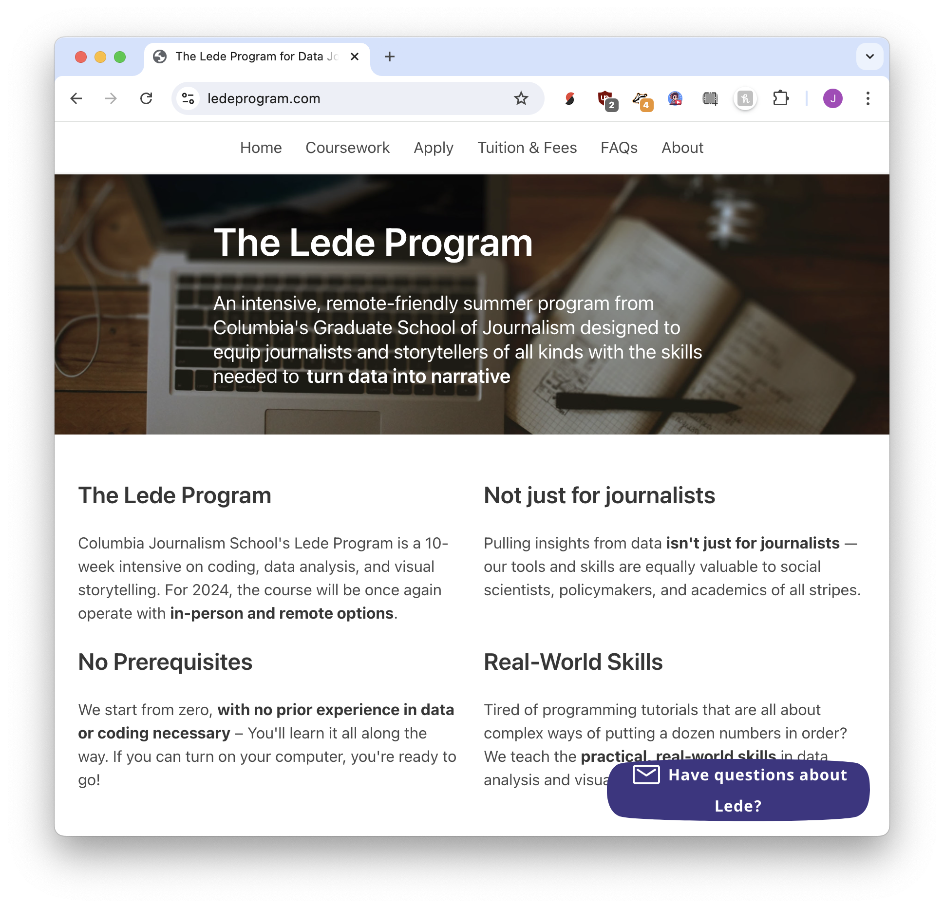
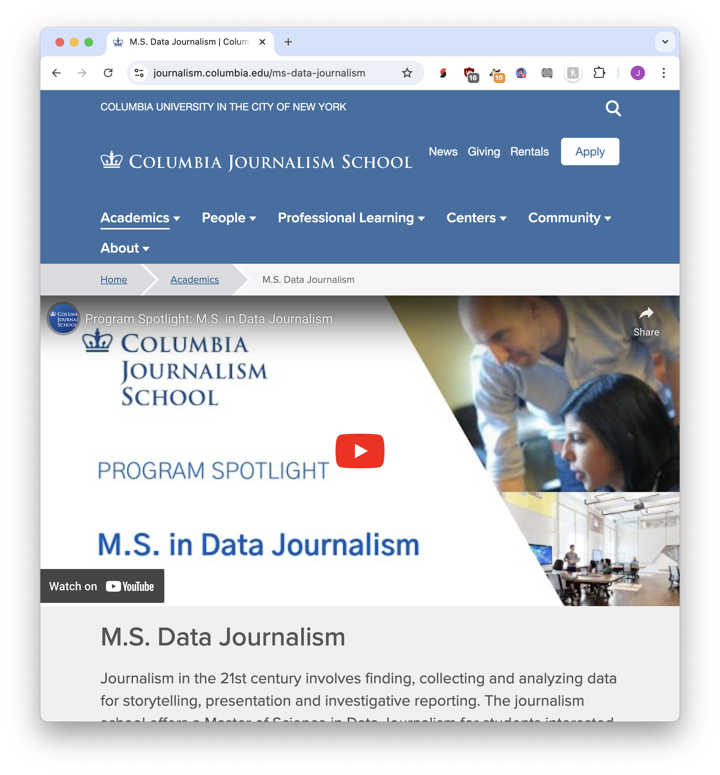
10 weeks
12 months

Slide 3
https://bit.ly/birn-data
Jonathan Soma
Columbia University
js4571@columbia.edu
@dangerscarf
AI for Reporting
tricks for the newsroom

Slide 4
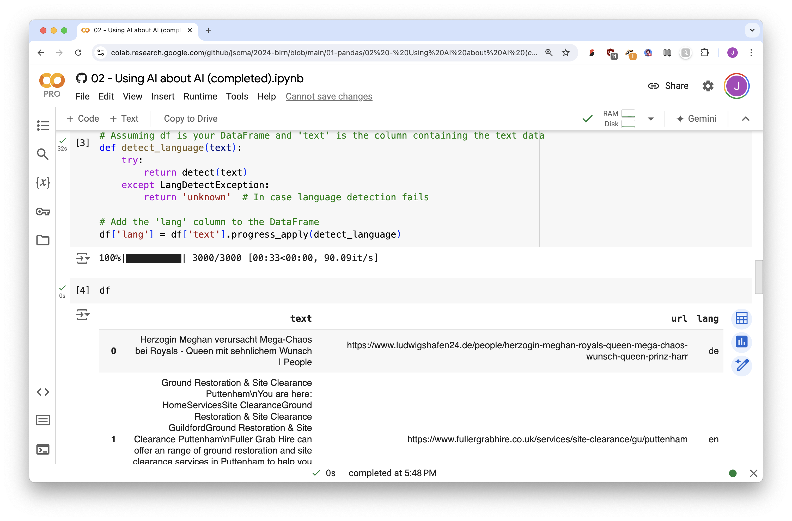
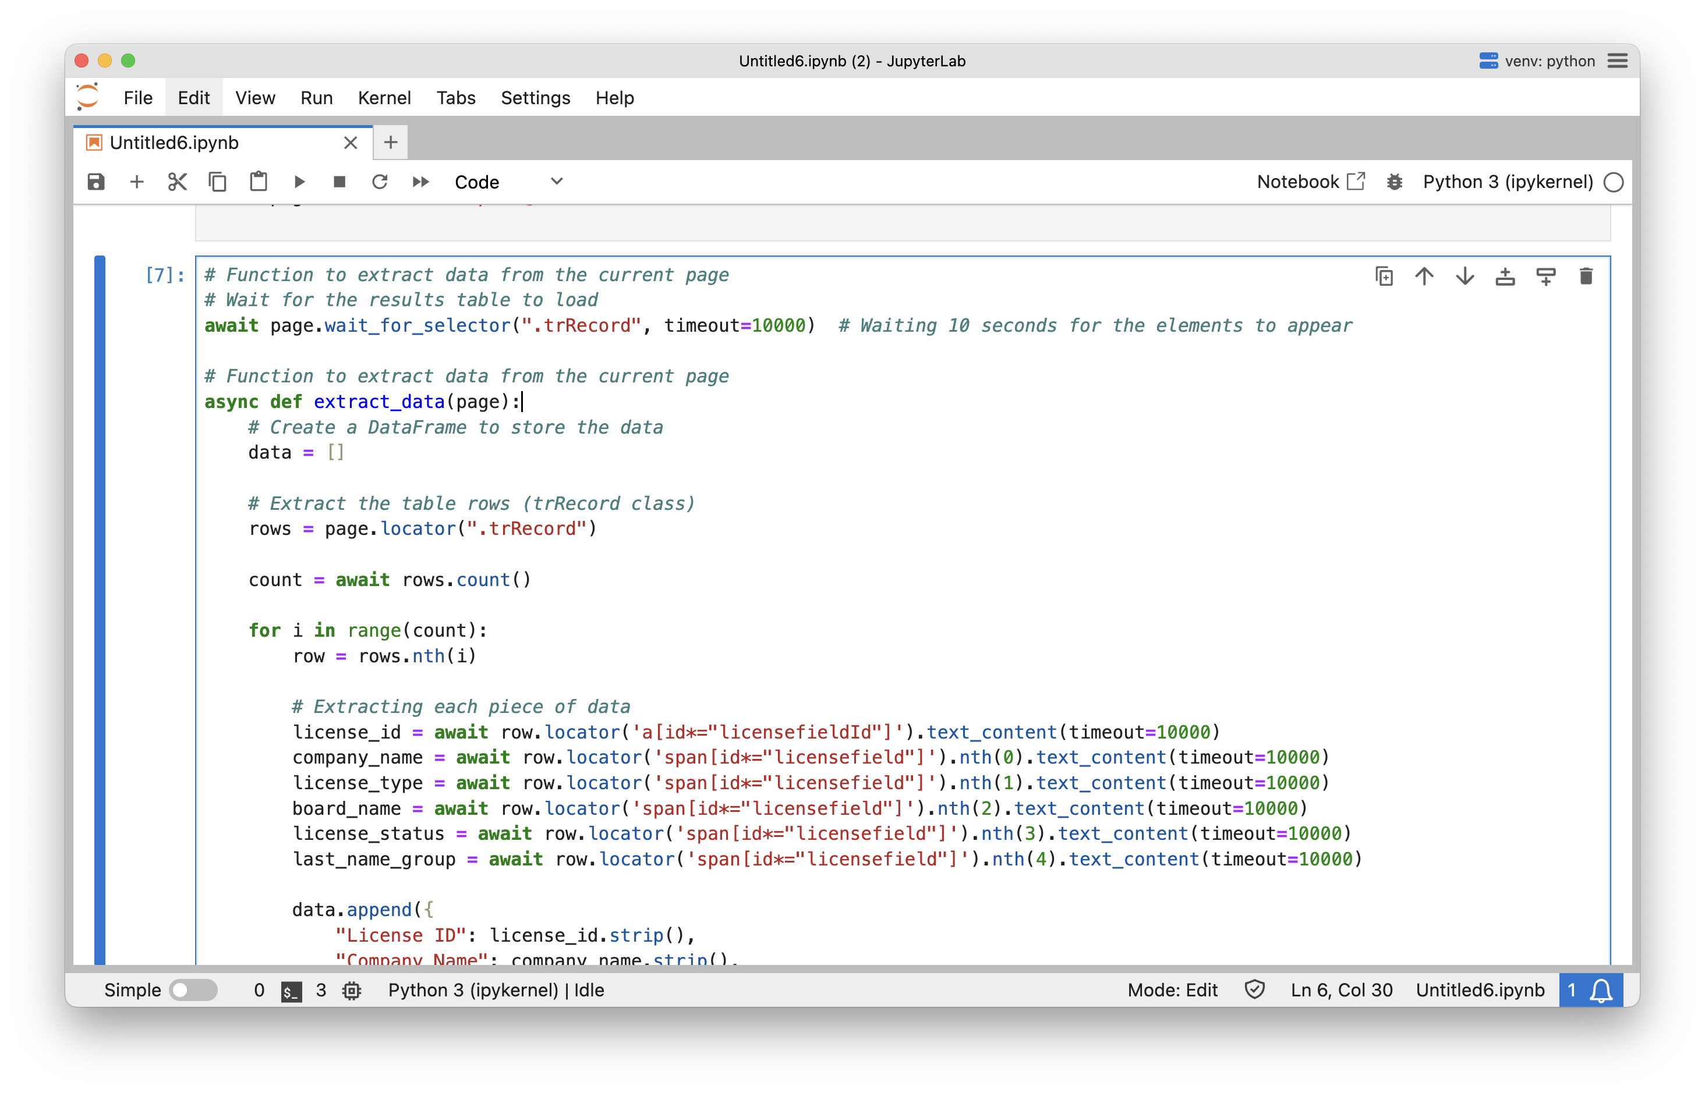
Scraping
Python + Playwright
Data Analysis
Python + pandas

Slide 5


AI wrote our code once we knew how to run Python and knew the word “pandas” and “dataframe”
Scraping
Python + Playwright
Data Analysis
Python + pandas
AI wrote our code once we knew how to inspect website code and that we use should Playwright

Slide 6

A.I. is
magicpatterns

Slide 7
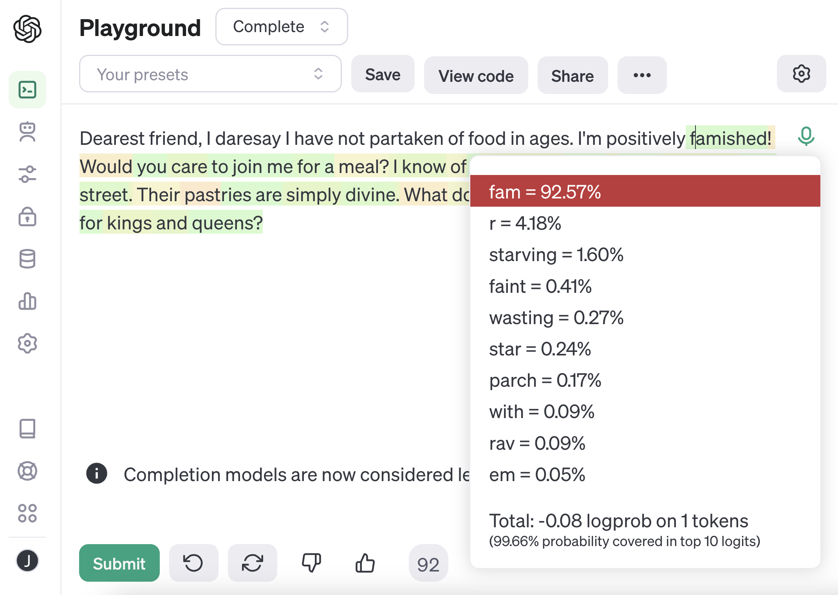

Slide 8
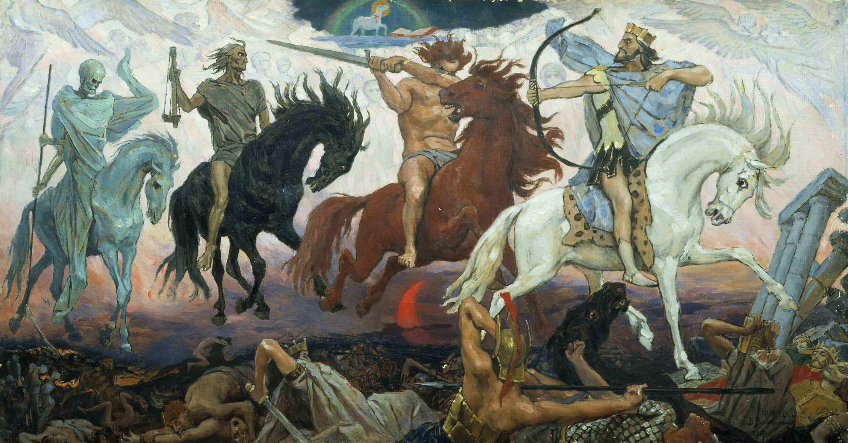
Bias
Low quality
Other things I
decide are bad
Hallucinations

Slide 9
A.I. should be used for
error-resilient tasks
“explain that???”

Slide 10
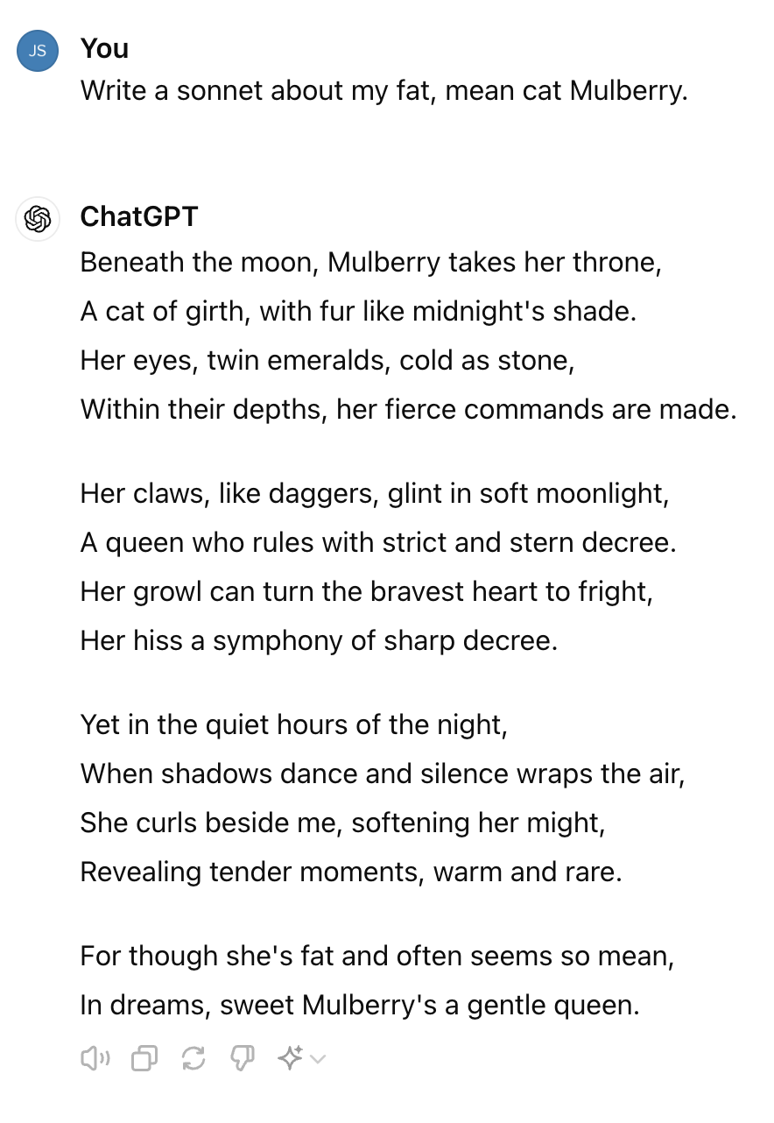
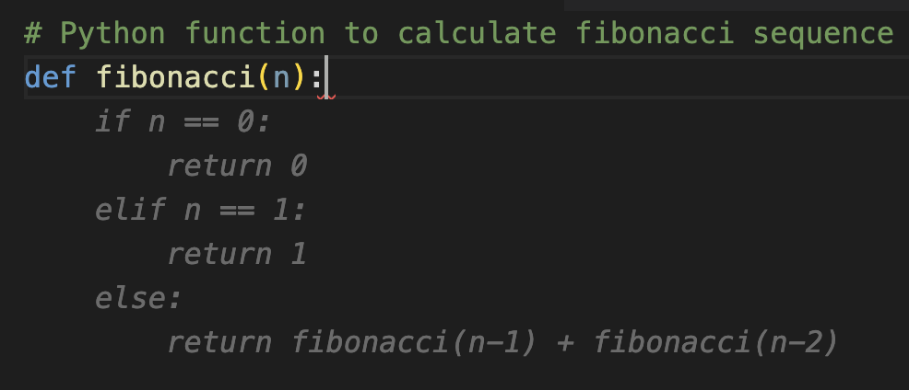
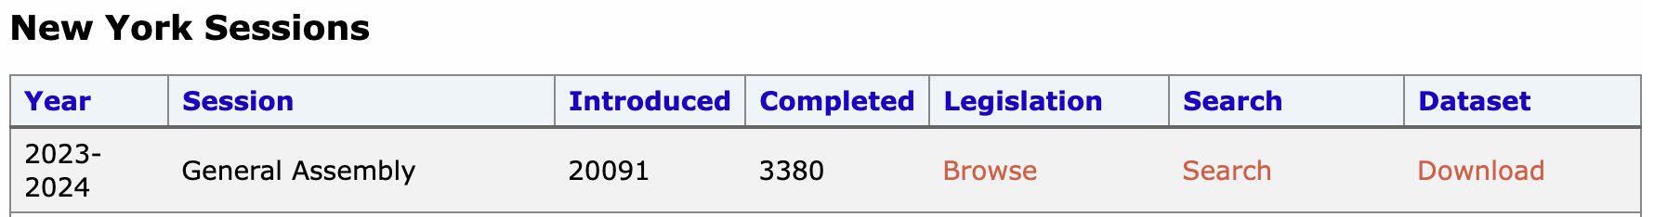
tight feedback loops
low-quality output is ignorable
errors are expected
(a.k.a. “intern work”)

Slide 11
tight feedback loops

Slide 12
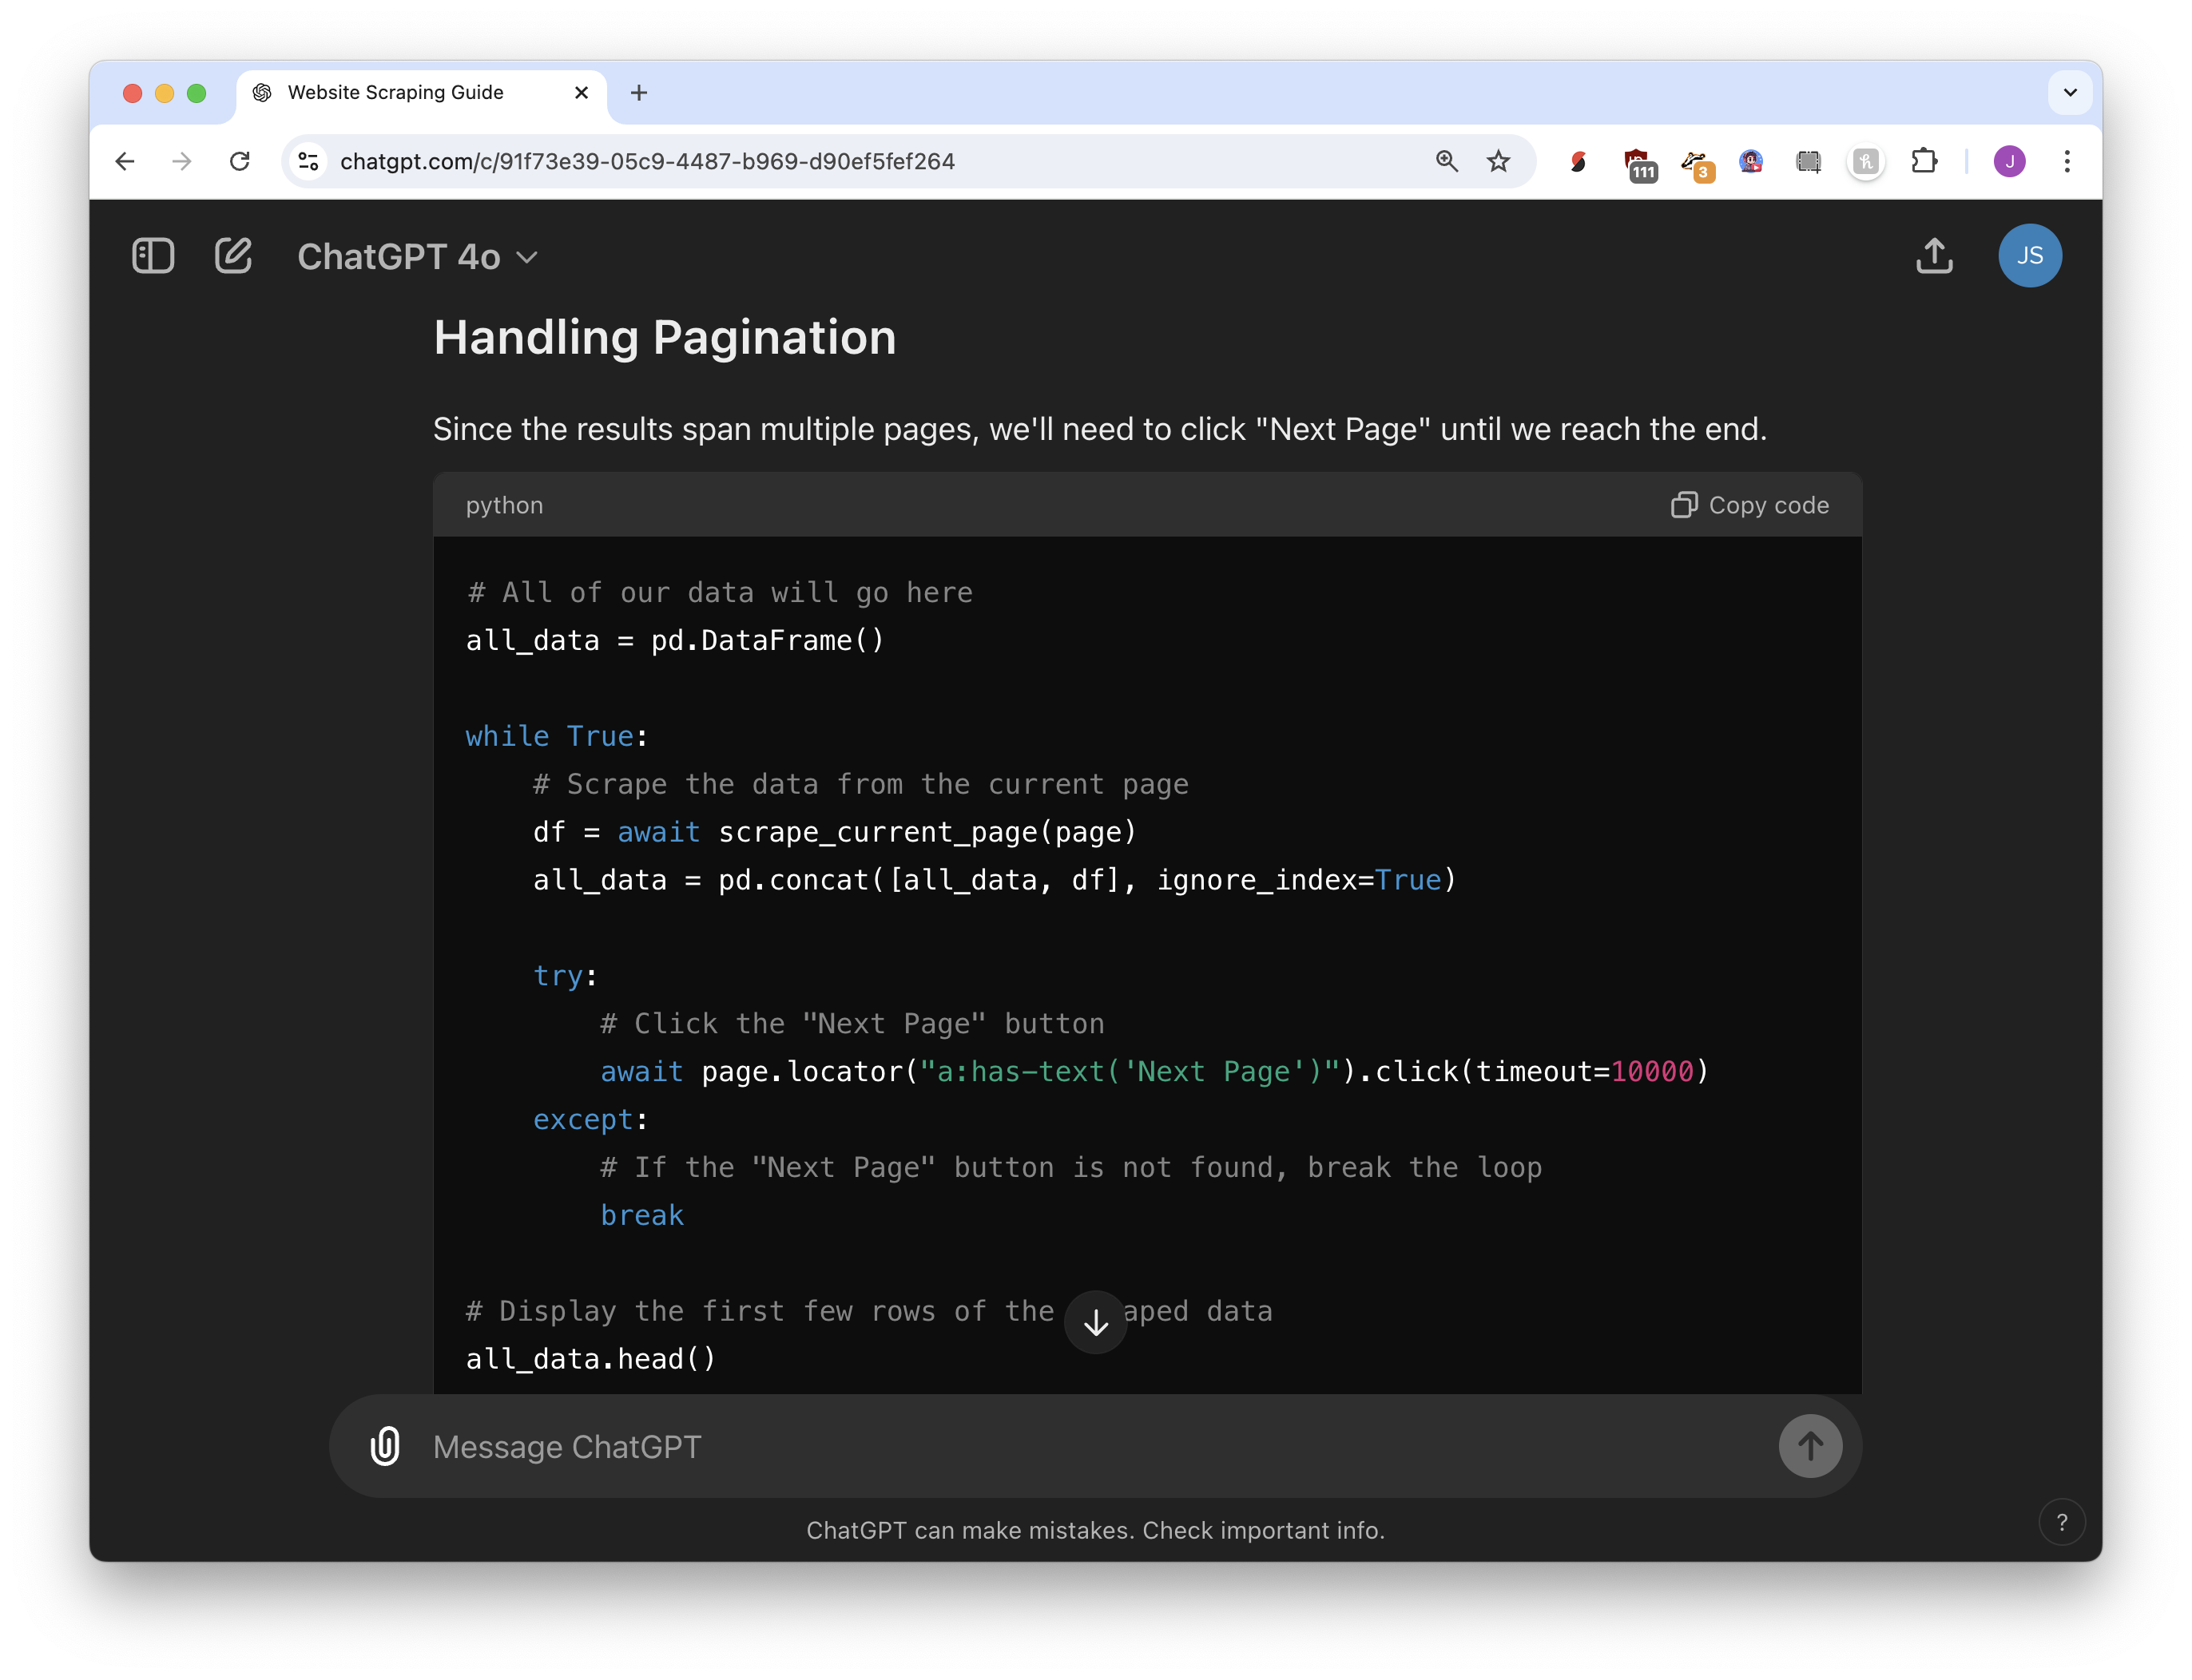
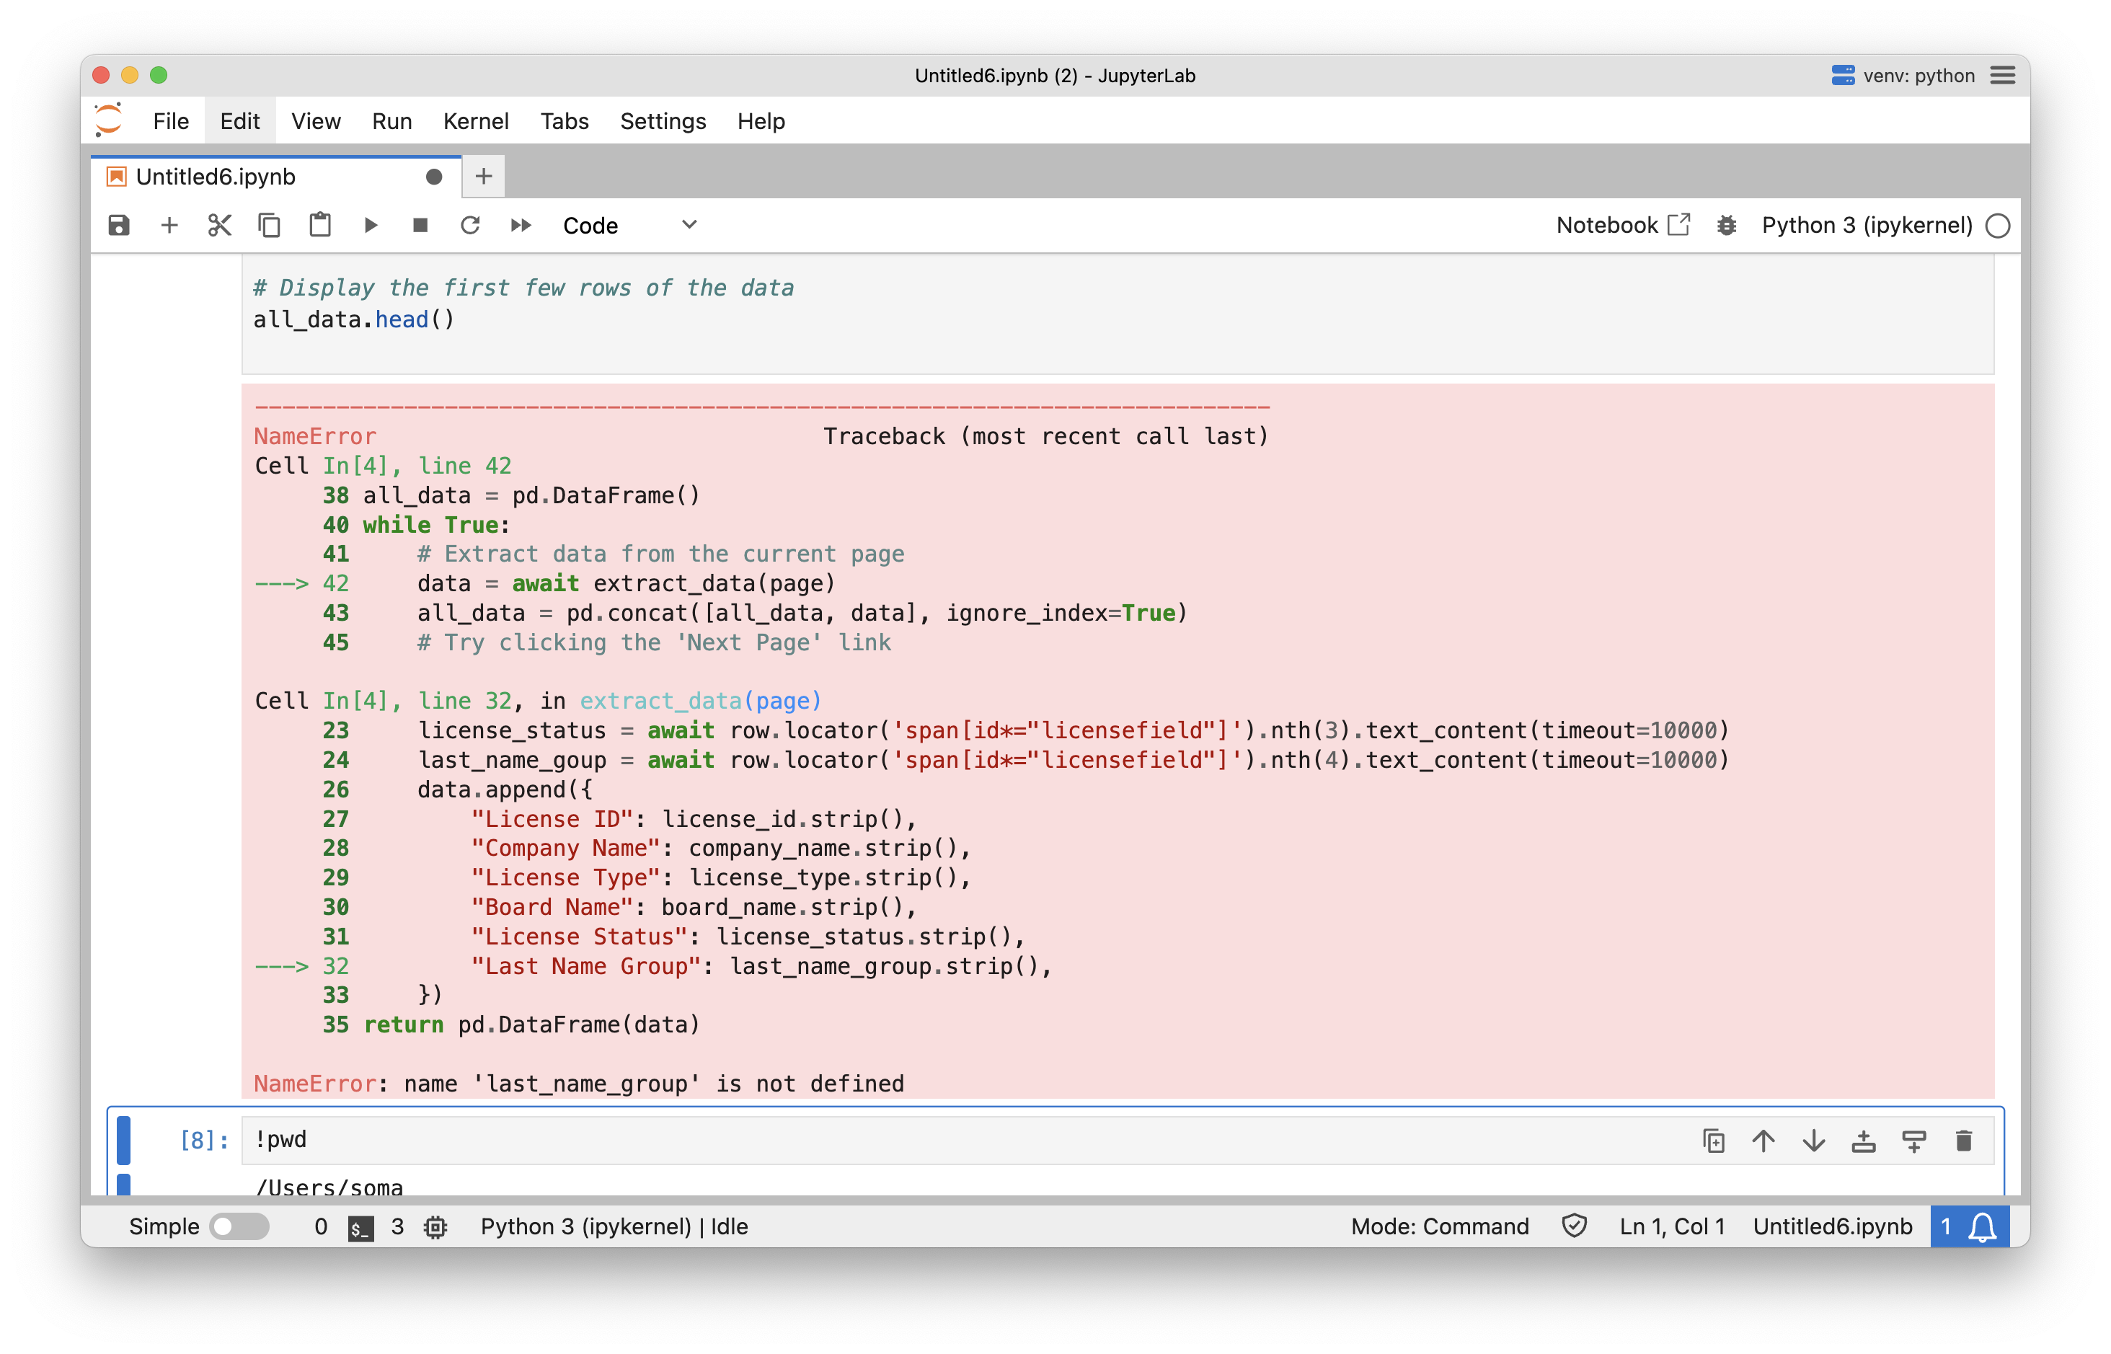
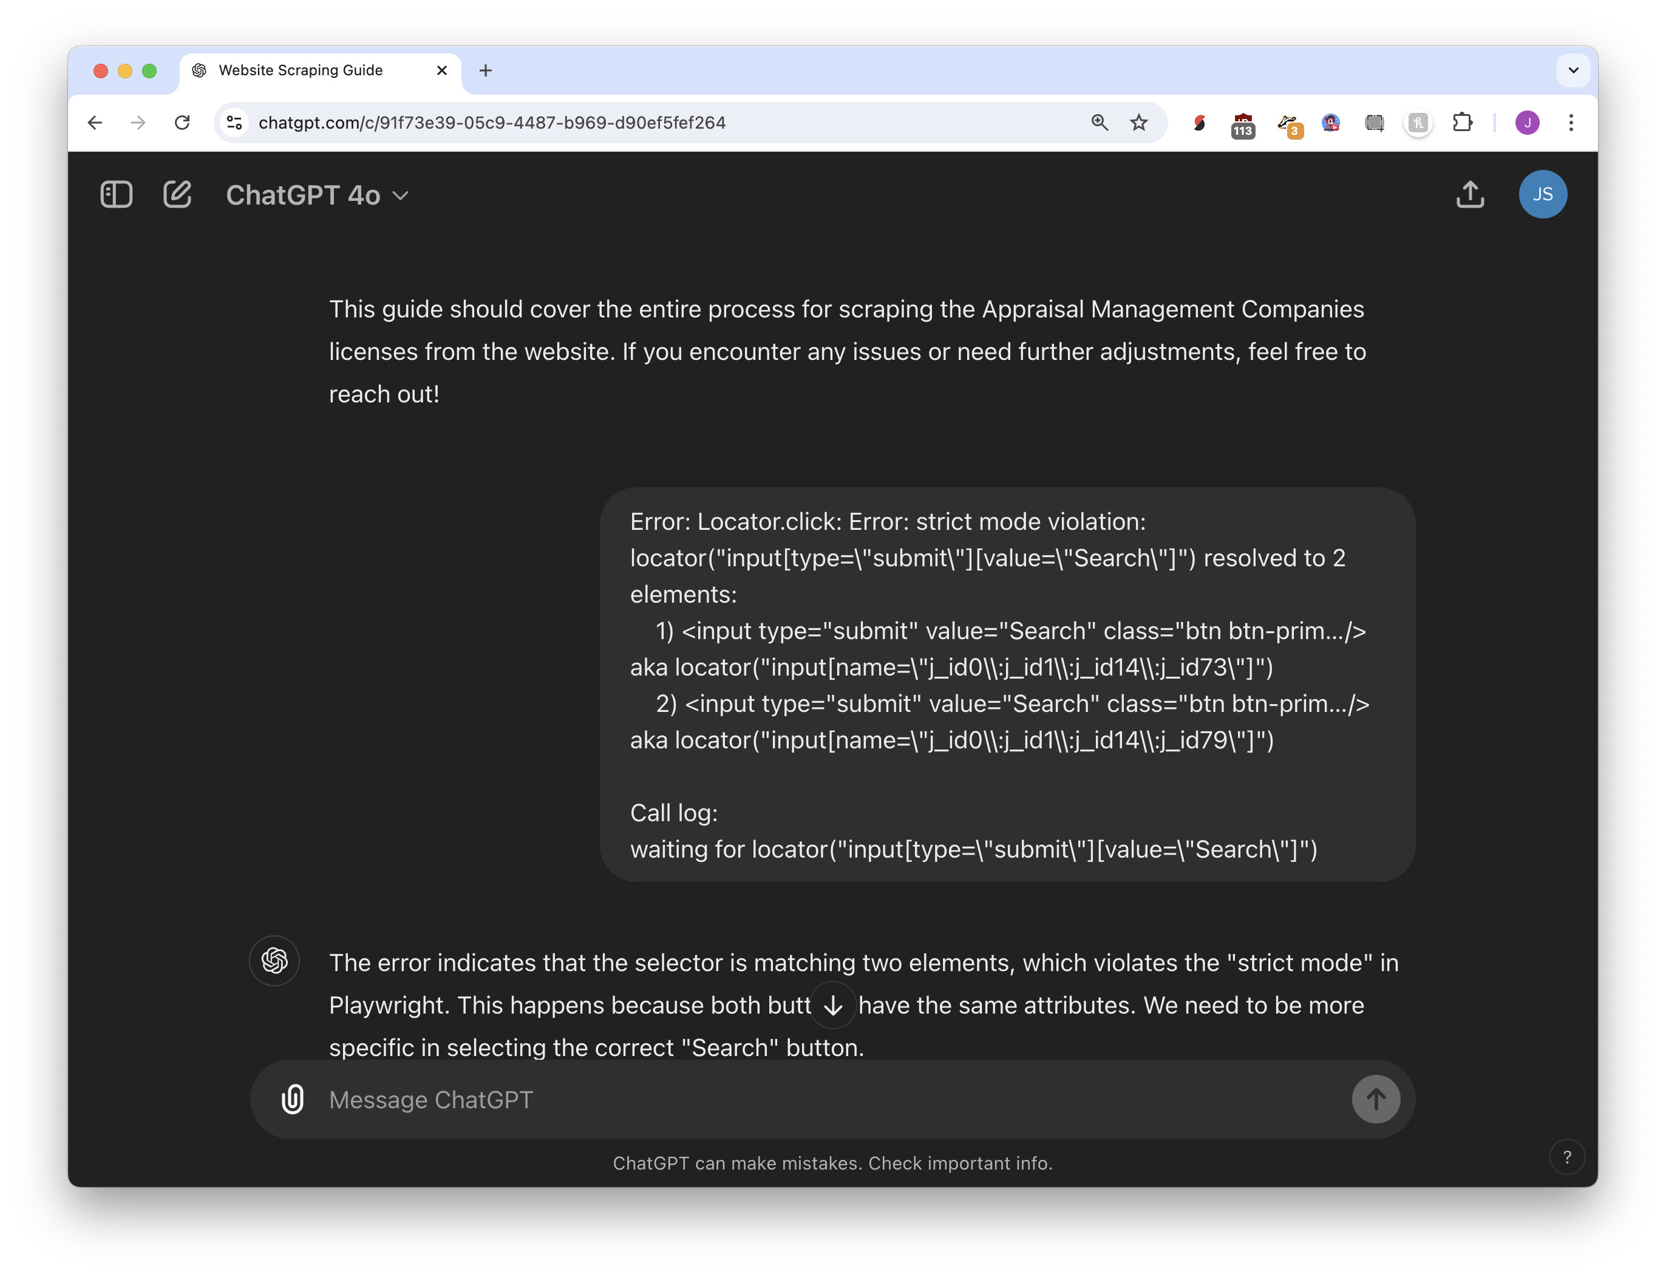

tight feedback loops

Slide 13
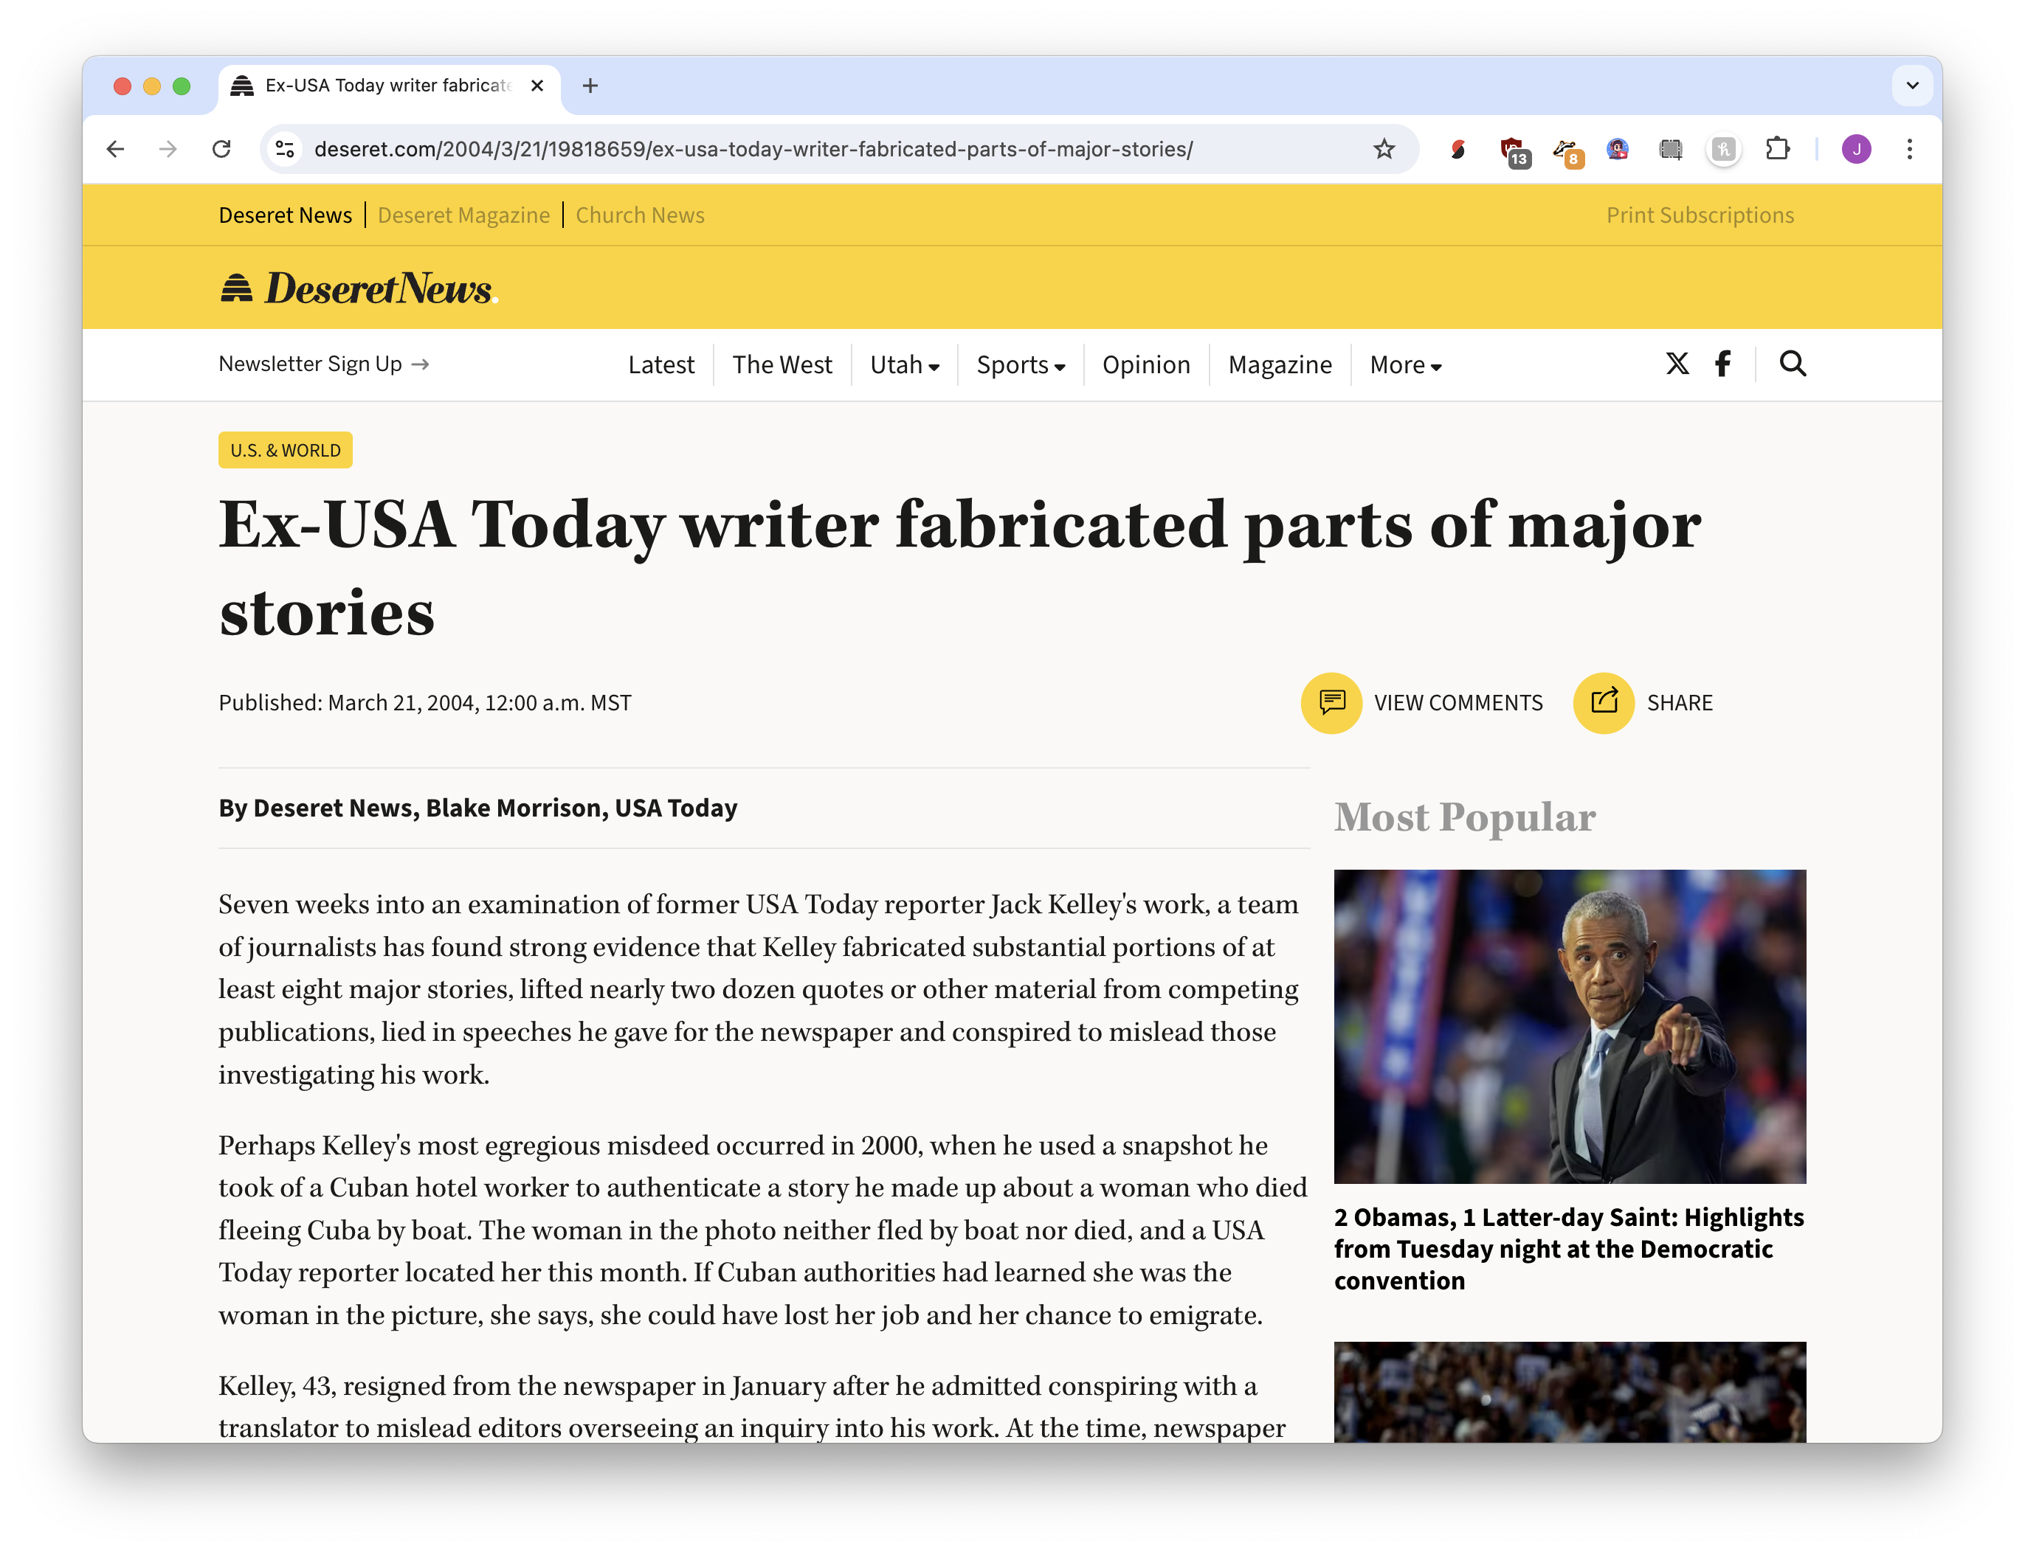




Slide 14
low-quality output is ignorable

Slide 15
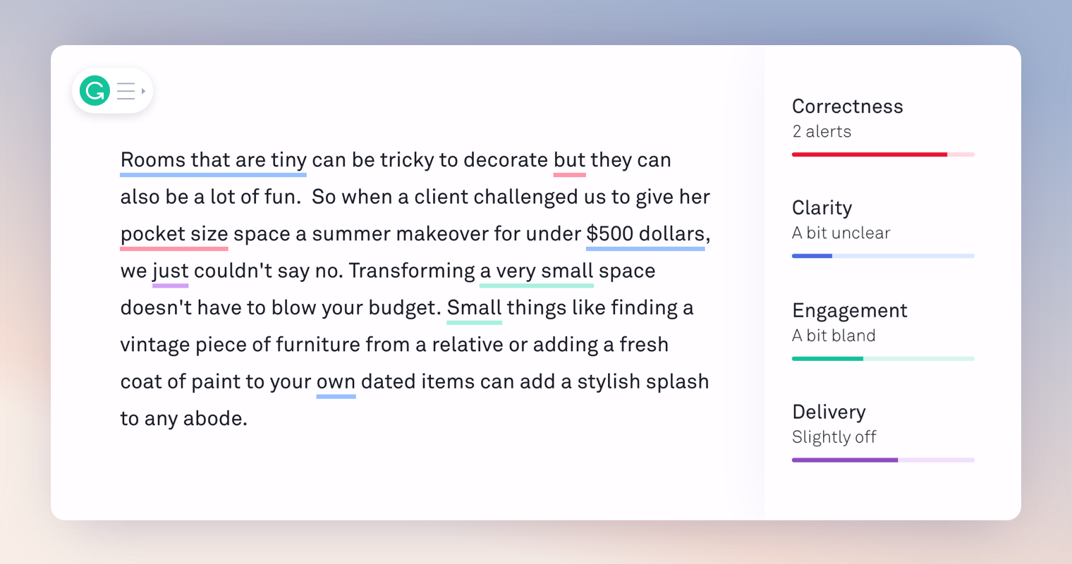
Grammarly

Slide 16
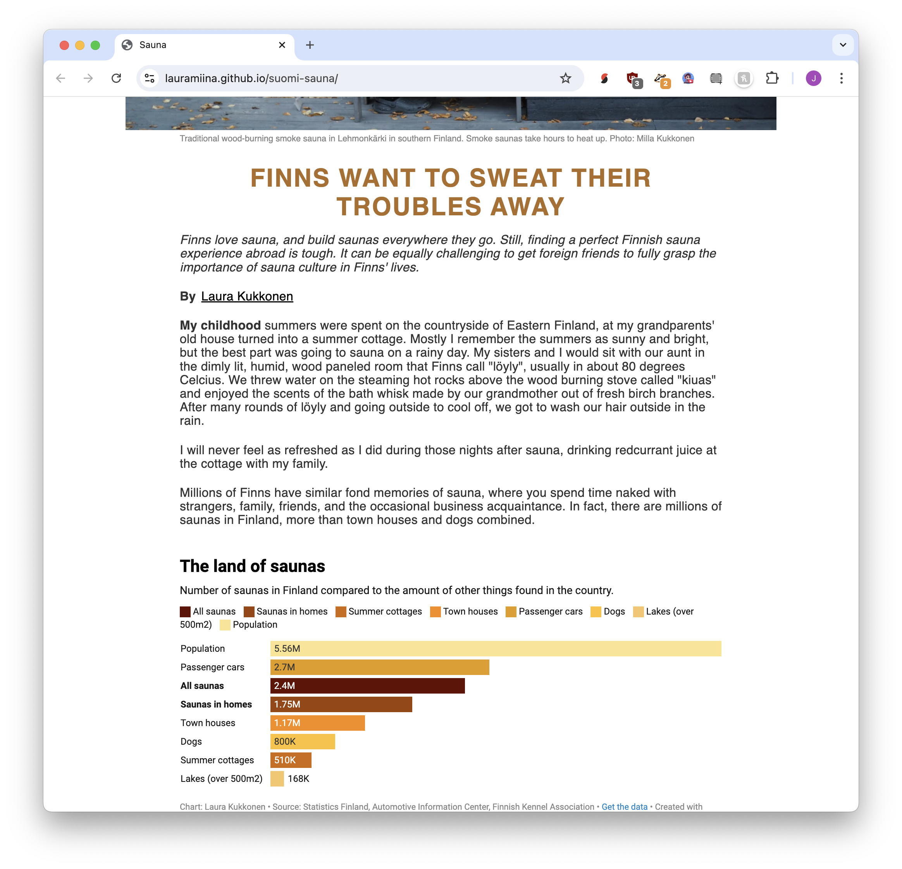
# Guide
Below are some of the most important AP Style rules for a data journalist to use when editing their work.
- Capitalization: Only capitalize proper nouns, titles directly before a name, and the first word in a sentence.
- Numbers: Spell out numbers one through nine; use figures for 10 and above, except in specific contexts (ages, dimensions, etc.).
…(many more rules)……..
# Instructions
Provide suggestions for improving the text of the work below as a list of bullet points. The text is provided under the 'PAGE TO BE EDITED' heading.
## Copy editing guidelines
- Only address the copy of the piece.
- Do not nest bullet points.
- Only use the AP style guide to make suggestions.
- Every bullet point must be something that needs to be fixed.
- Be specific and concise.
- Each bullet point should include a specific text change, NOT a general suggestion.

Slide 17
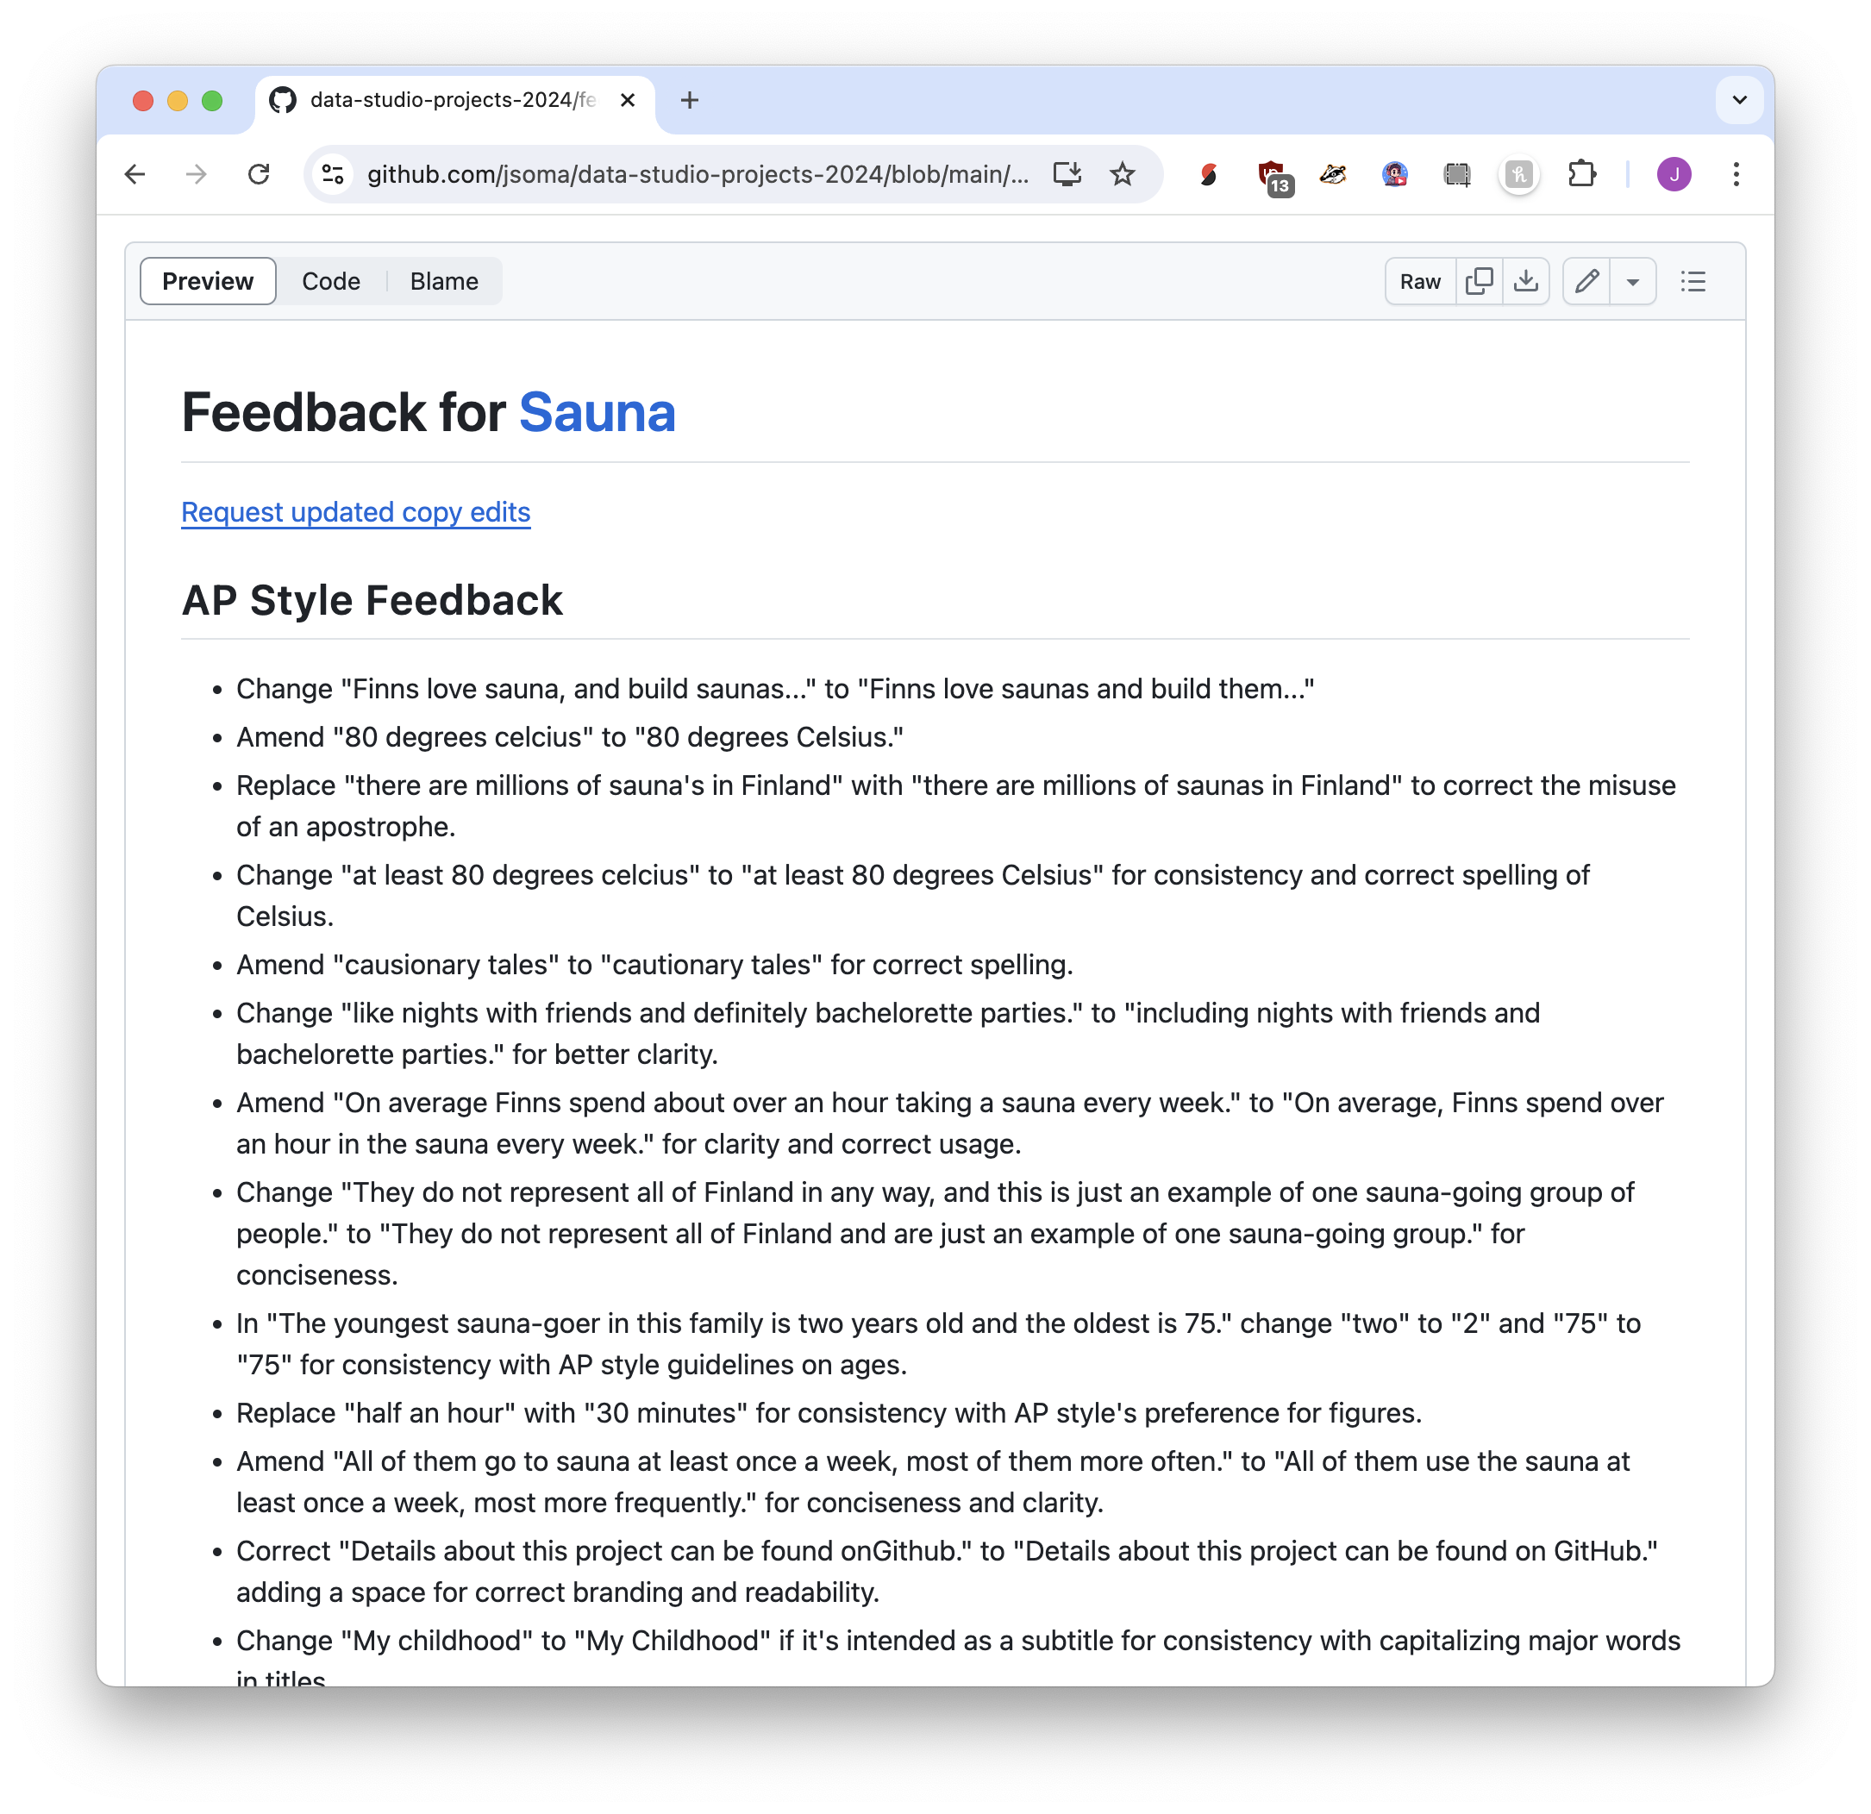
Replace "there are millions of sauna's in Finland" with "there are millions of saunas in Finland" to correct the misuse of an apostrophe.
Change "two" to "2" and "75" to "75" for consistency with AP style guidelines on ages.

Slide 18



Suggestions!
not demands!
if it’s silly, ignore it

Slide 19
tight feedback loops
low-quality output is ignorable
errors are expected
(a.k.a. “intern work”)

Slide 20
errors are expected
(a.k.a. “intern work”)

Slide 21
Large language models don’t understand facts or concepts, they only know statistical probability

Slide 22
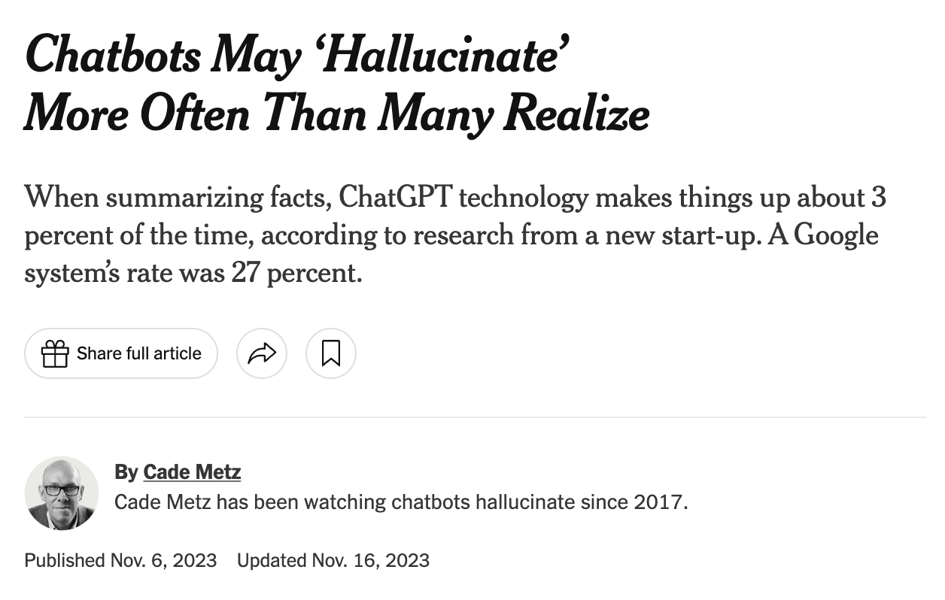
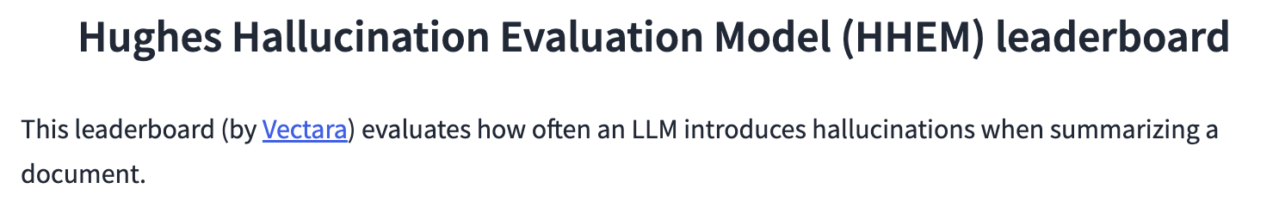
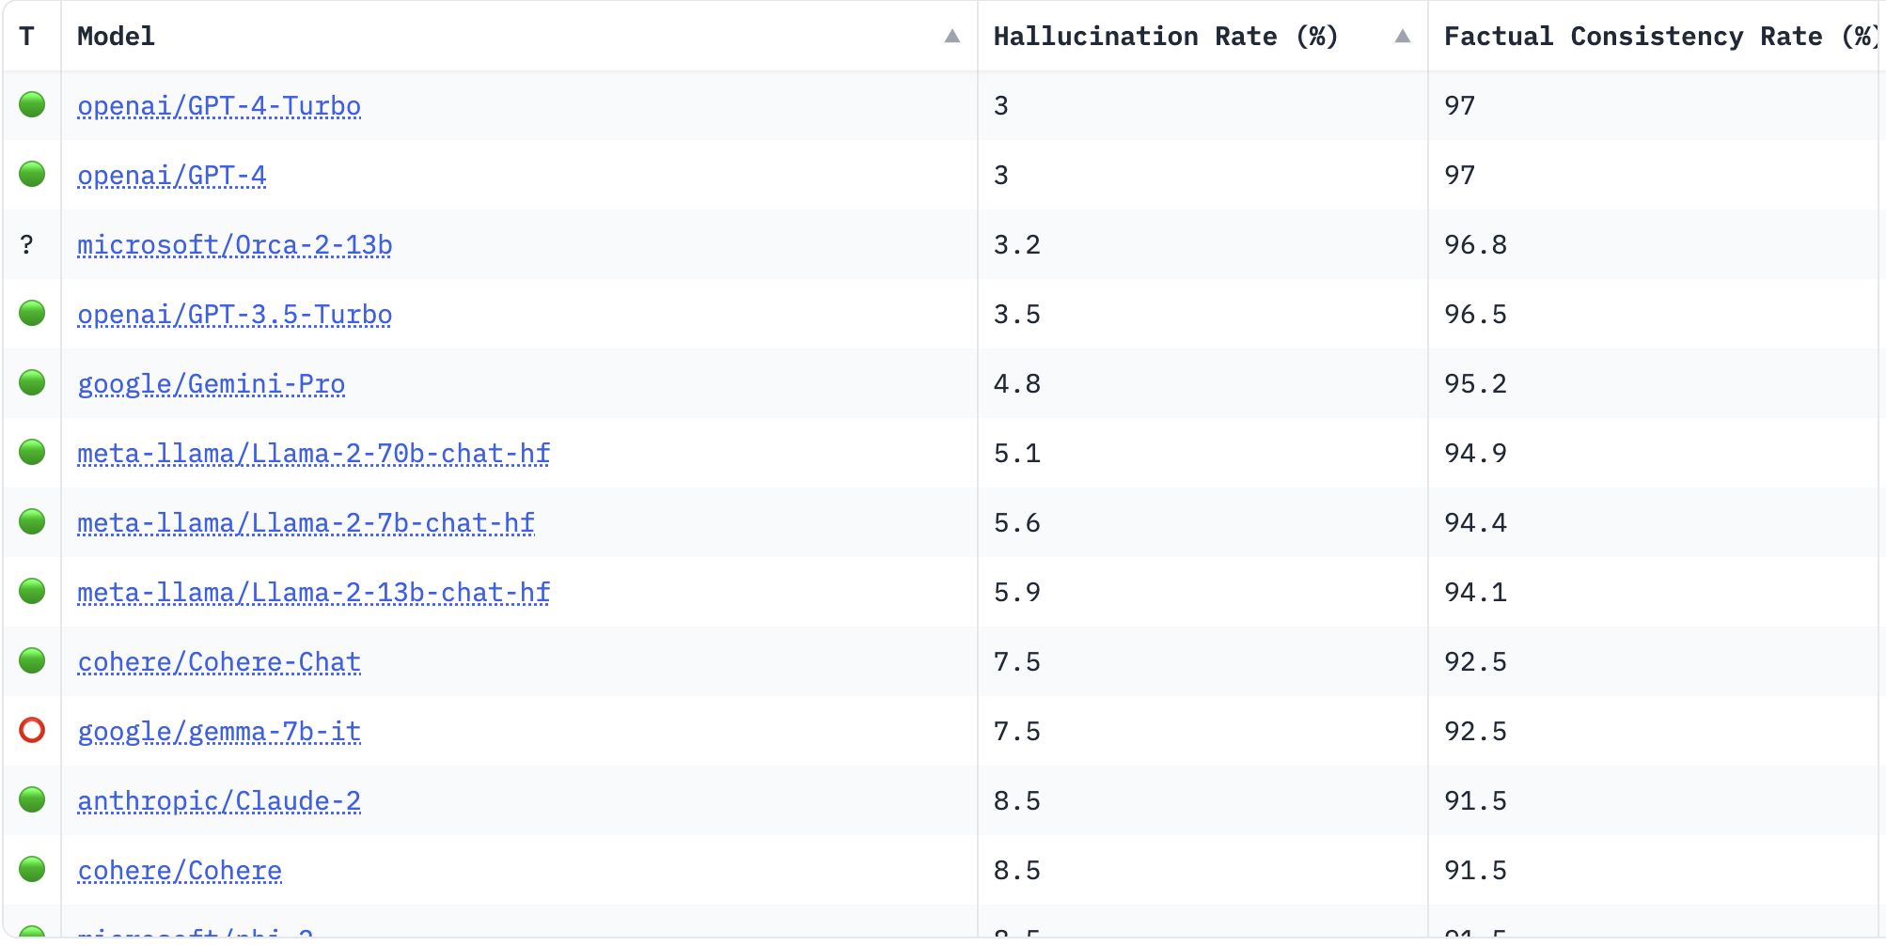
Can be dangerous for translation and summarization

Slide 23
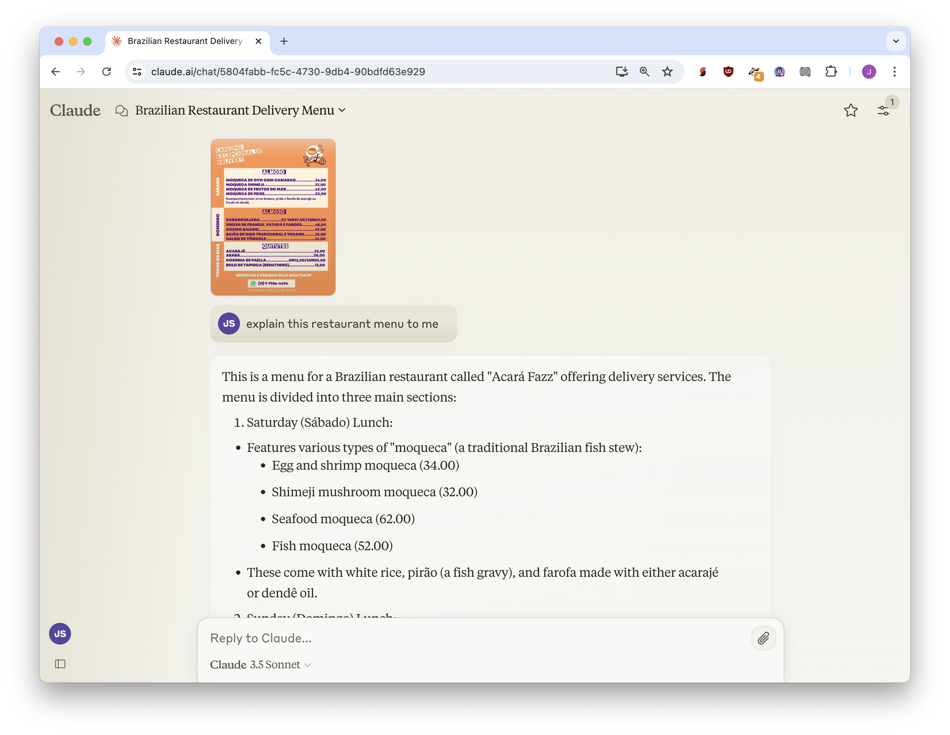
Translating a restaurant menu?
Errors are probably okay!

Slide 24
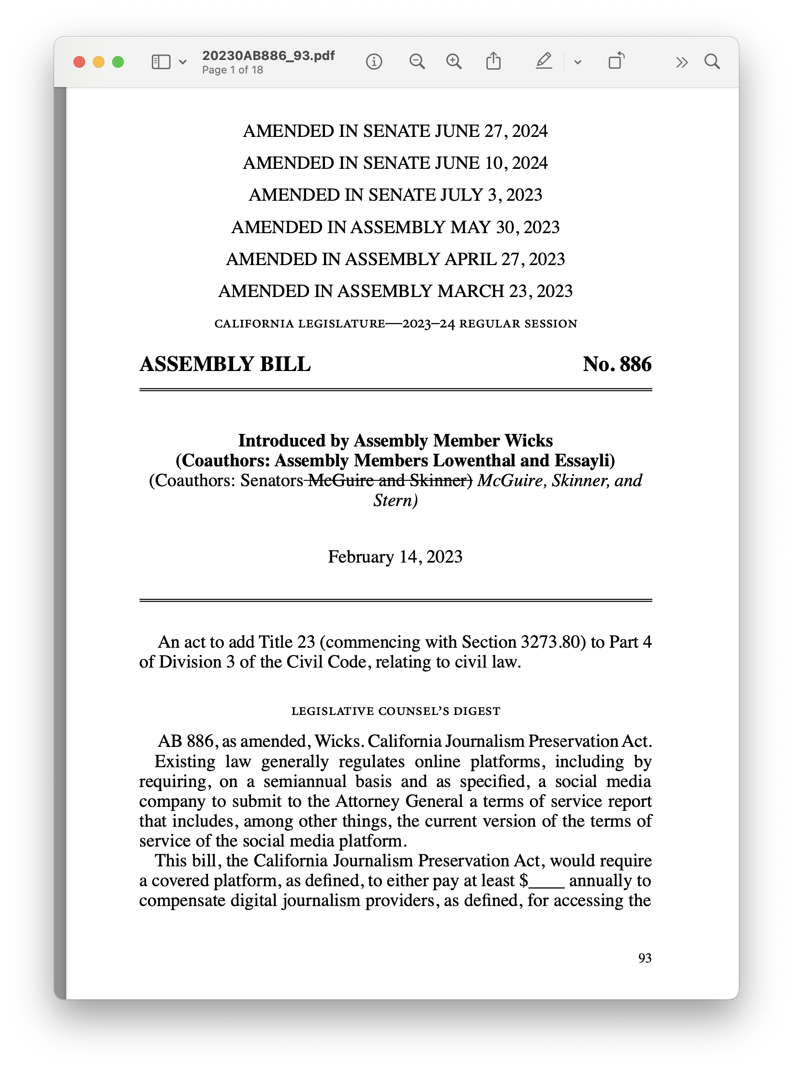
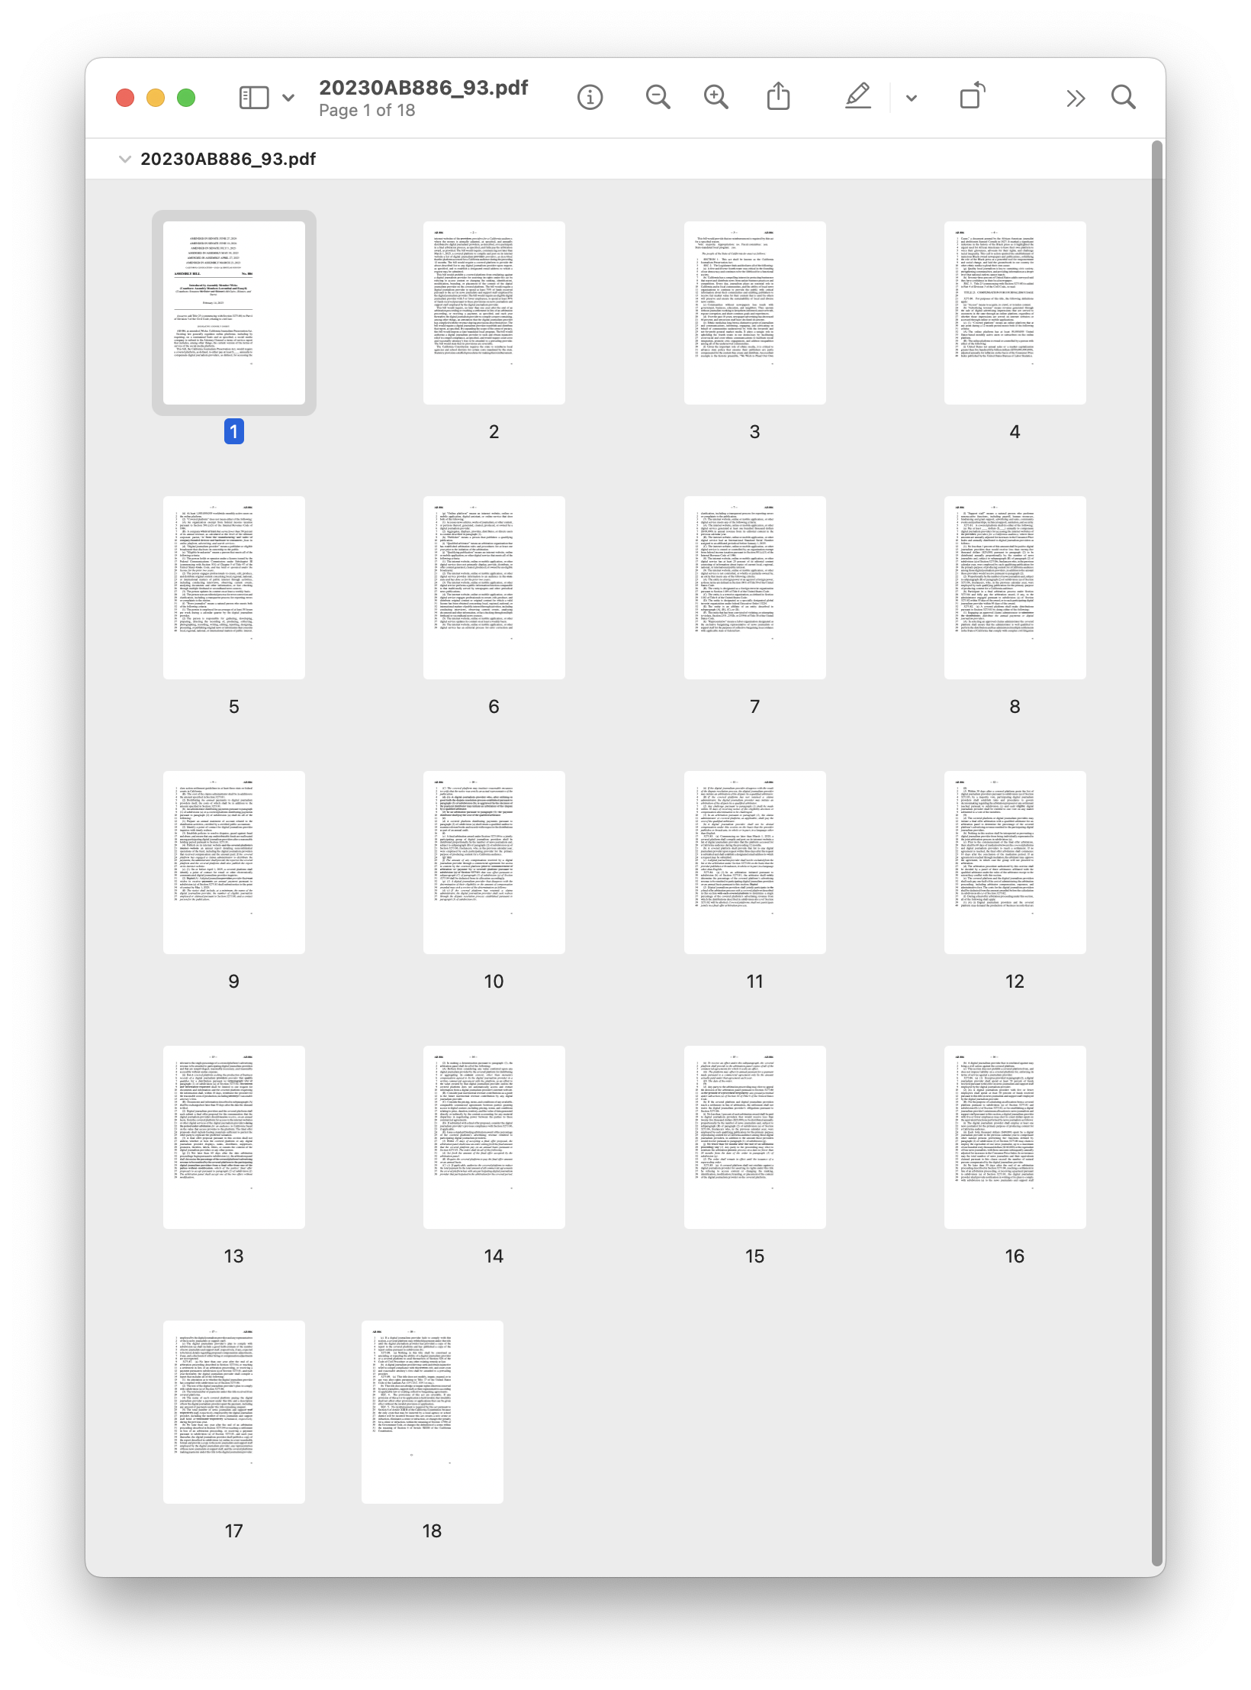
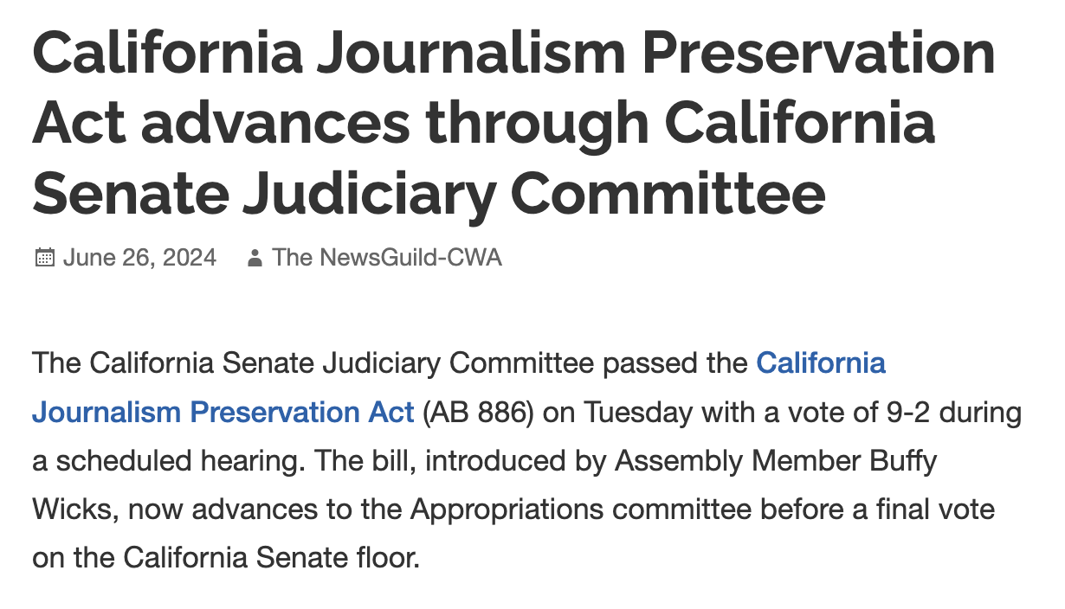
Writing a story about a law?
Errors are NOT okay!

Slide 25
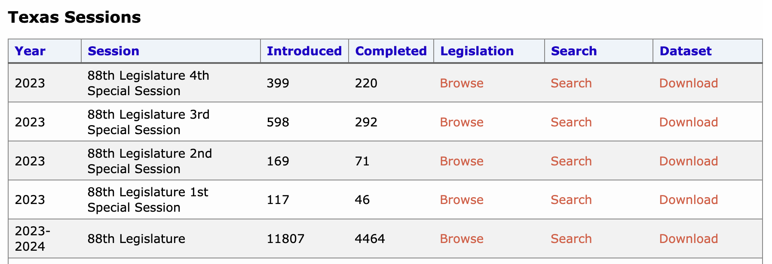

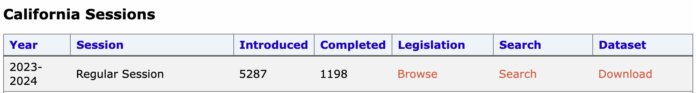

Slide 26
When we have many documents, maybe we want to…
Find some examples of similar pieces of news legislation
Find what percent of legislation is about journalism
Get an alert each time journalism legislation is introduced
Find what legislators proposed legislation about journalism
In these situations, maybe a small error rate is okay?

Slide 27
sometimes you have many documents and want
a little information
from or about each of them

Slide 28
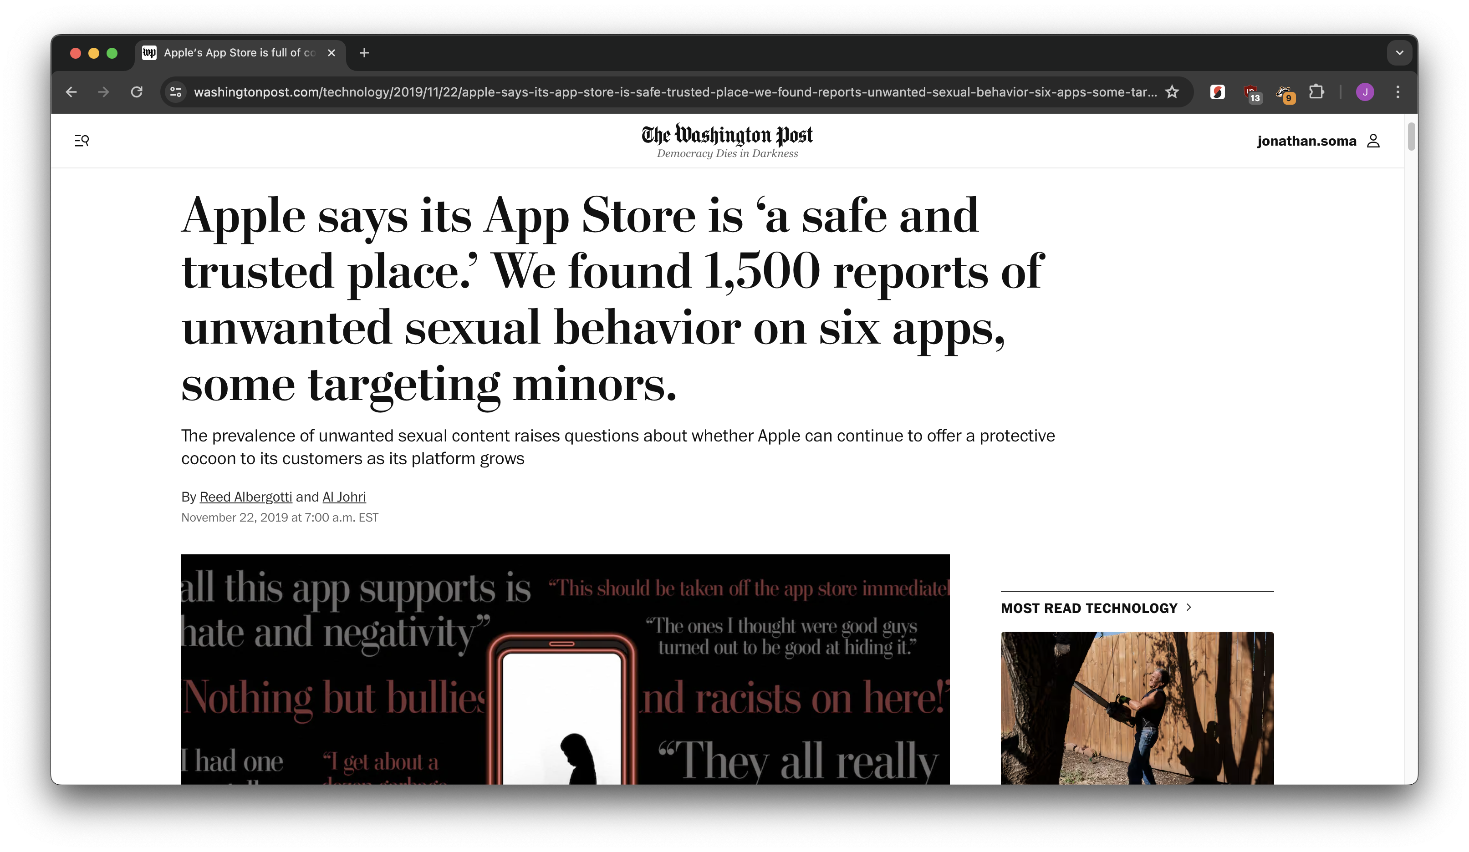
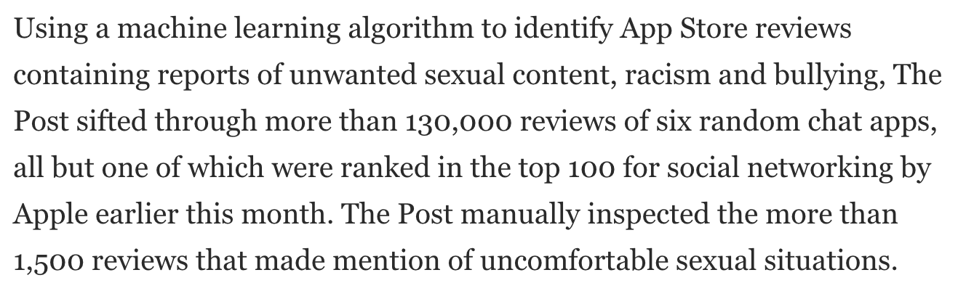
an example

Slide 29
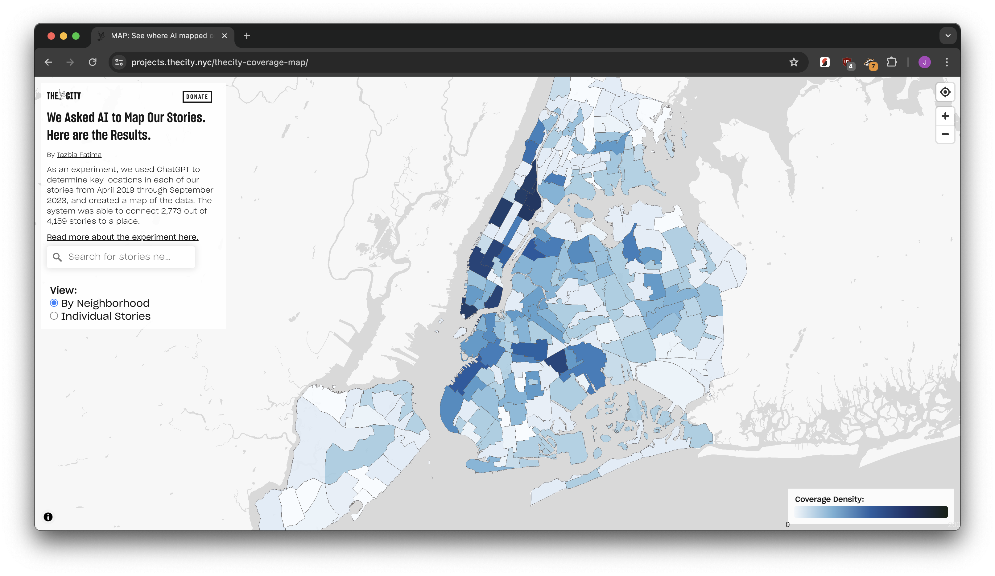
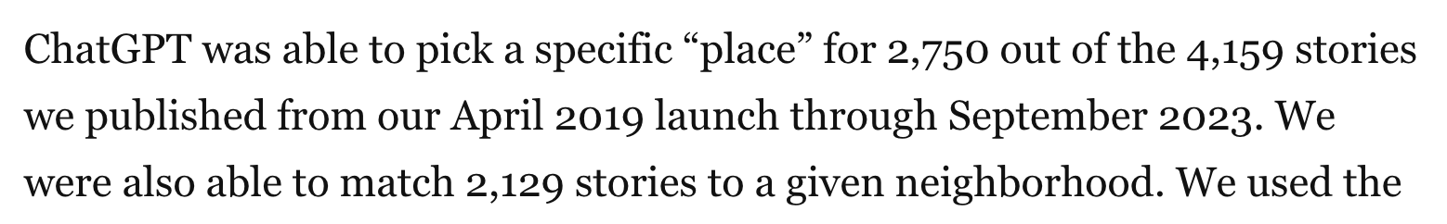
an example

Slide 30
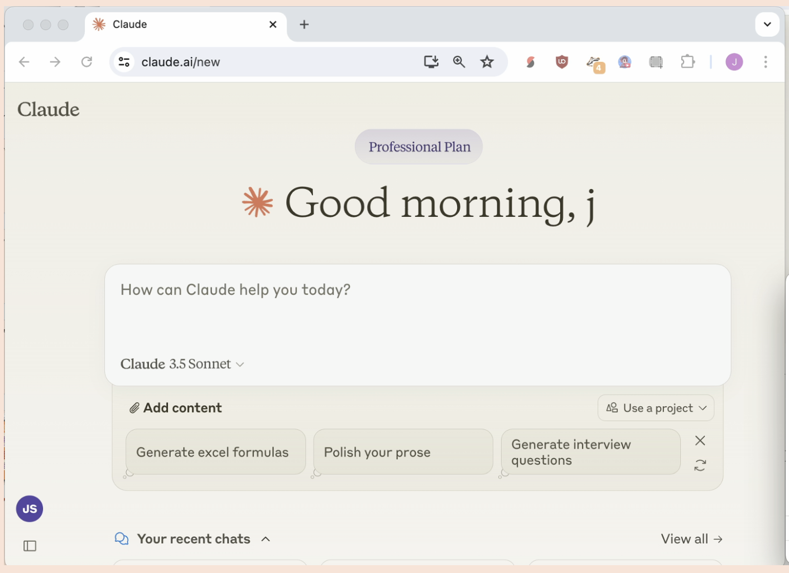
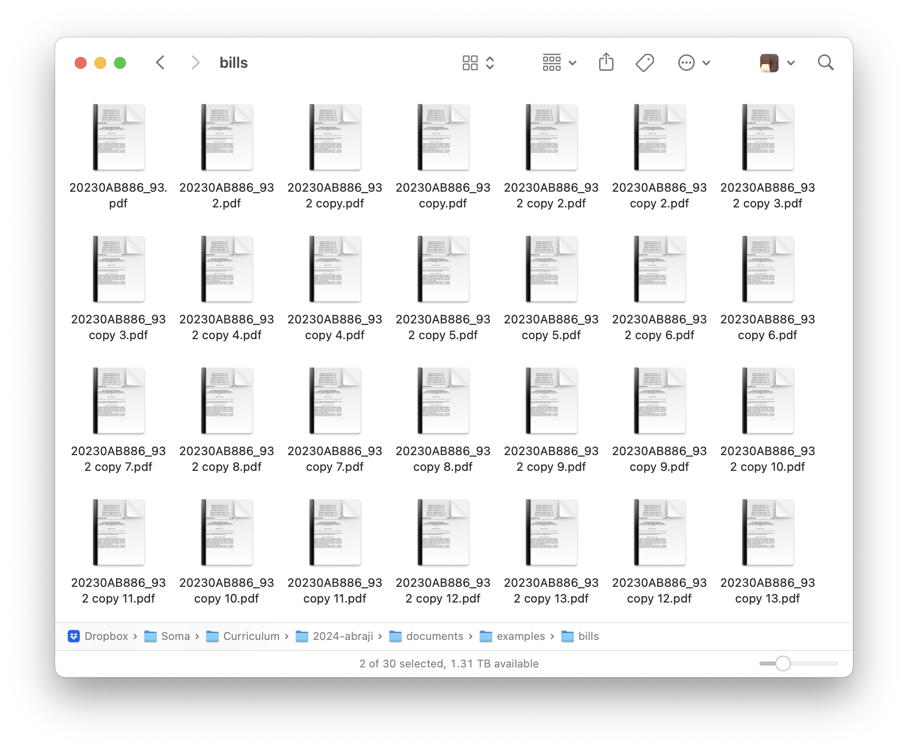





Slide 31
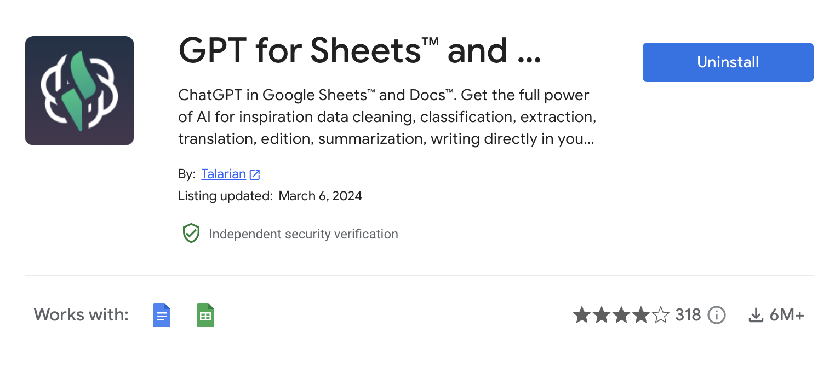
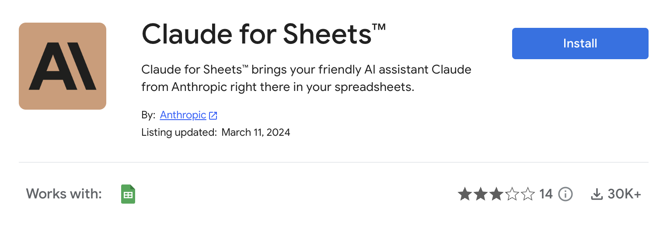
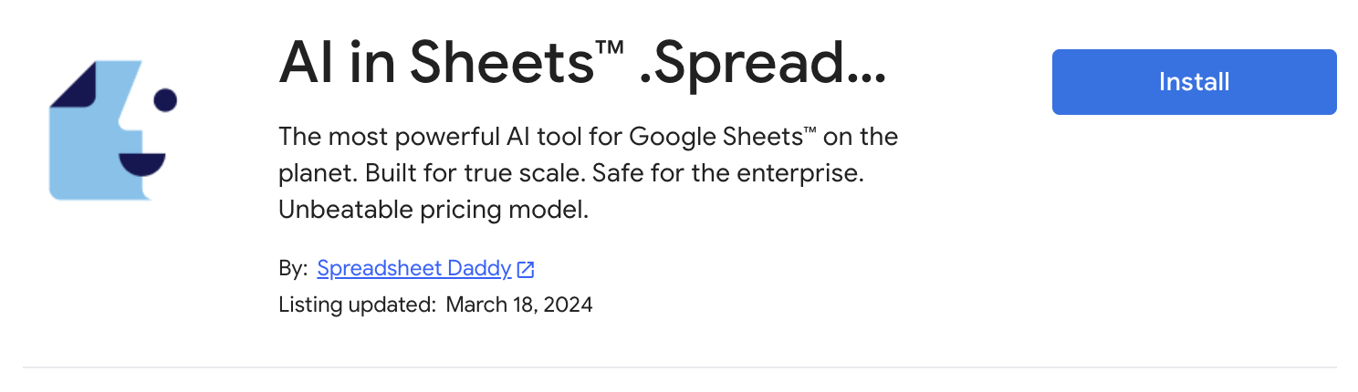

Slide 32
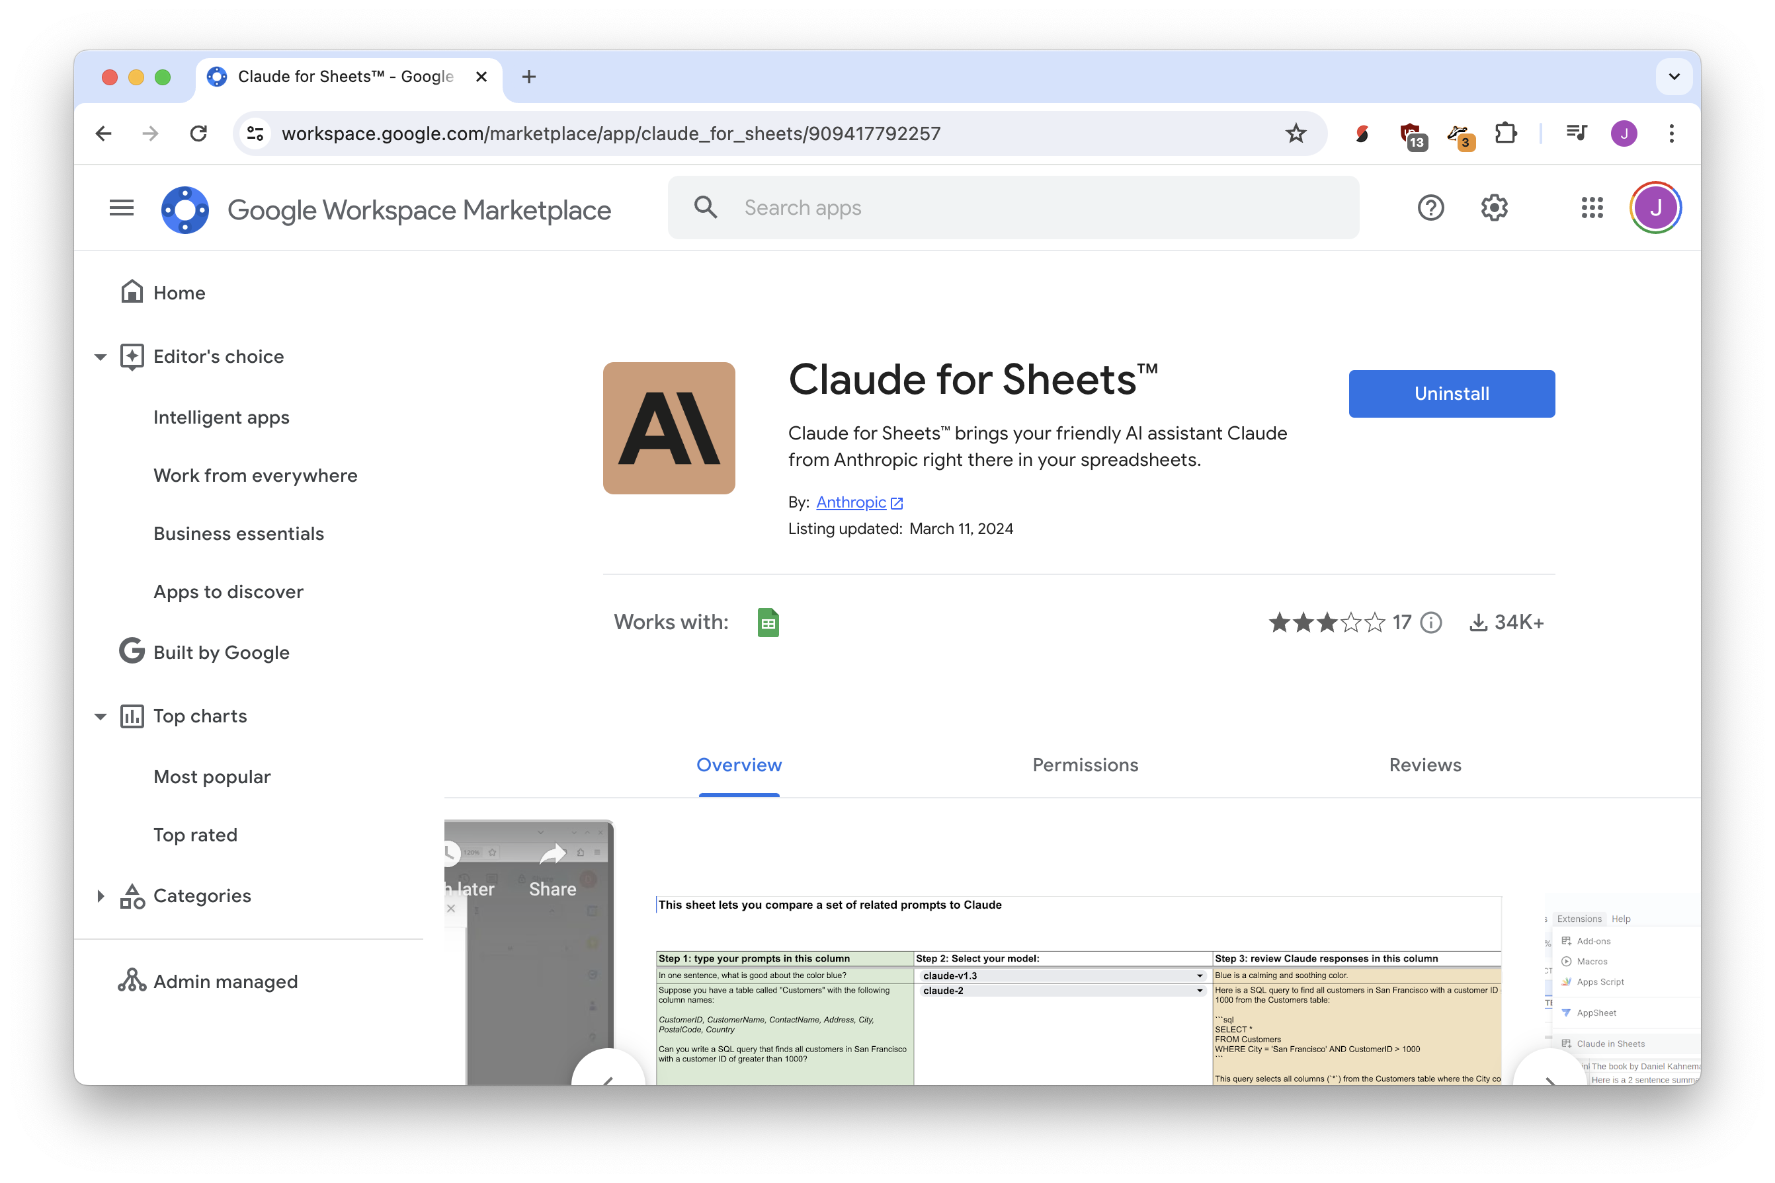

Slide 33
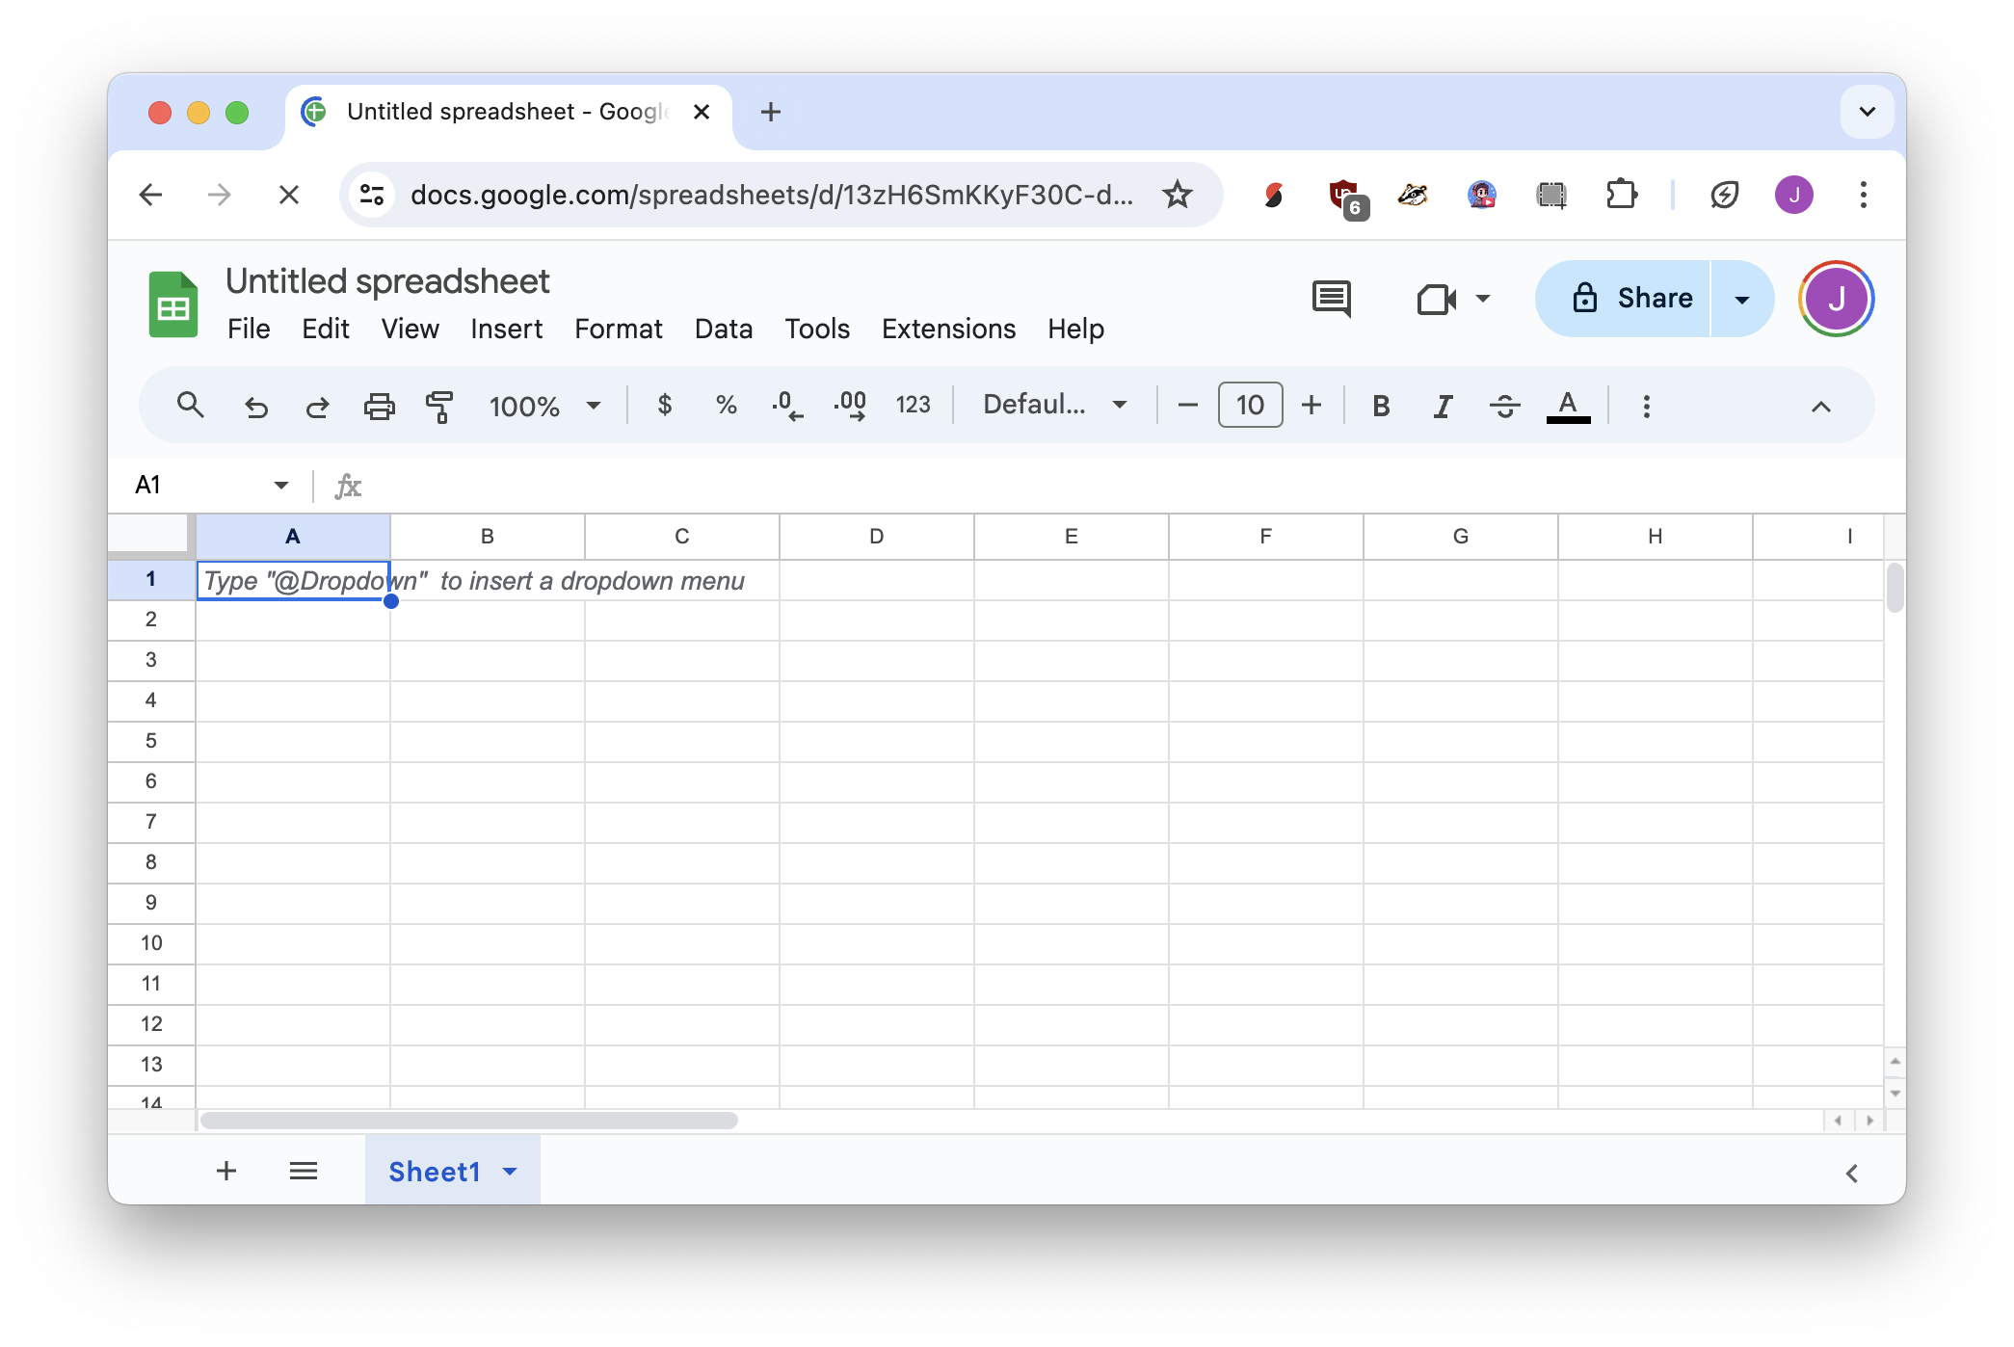
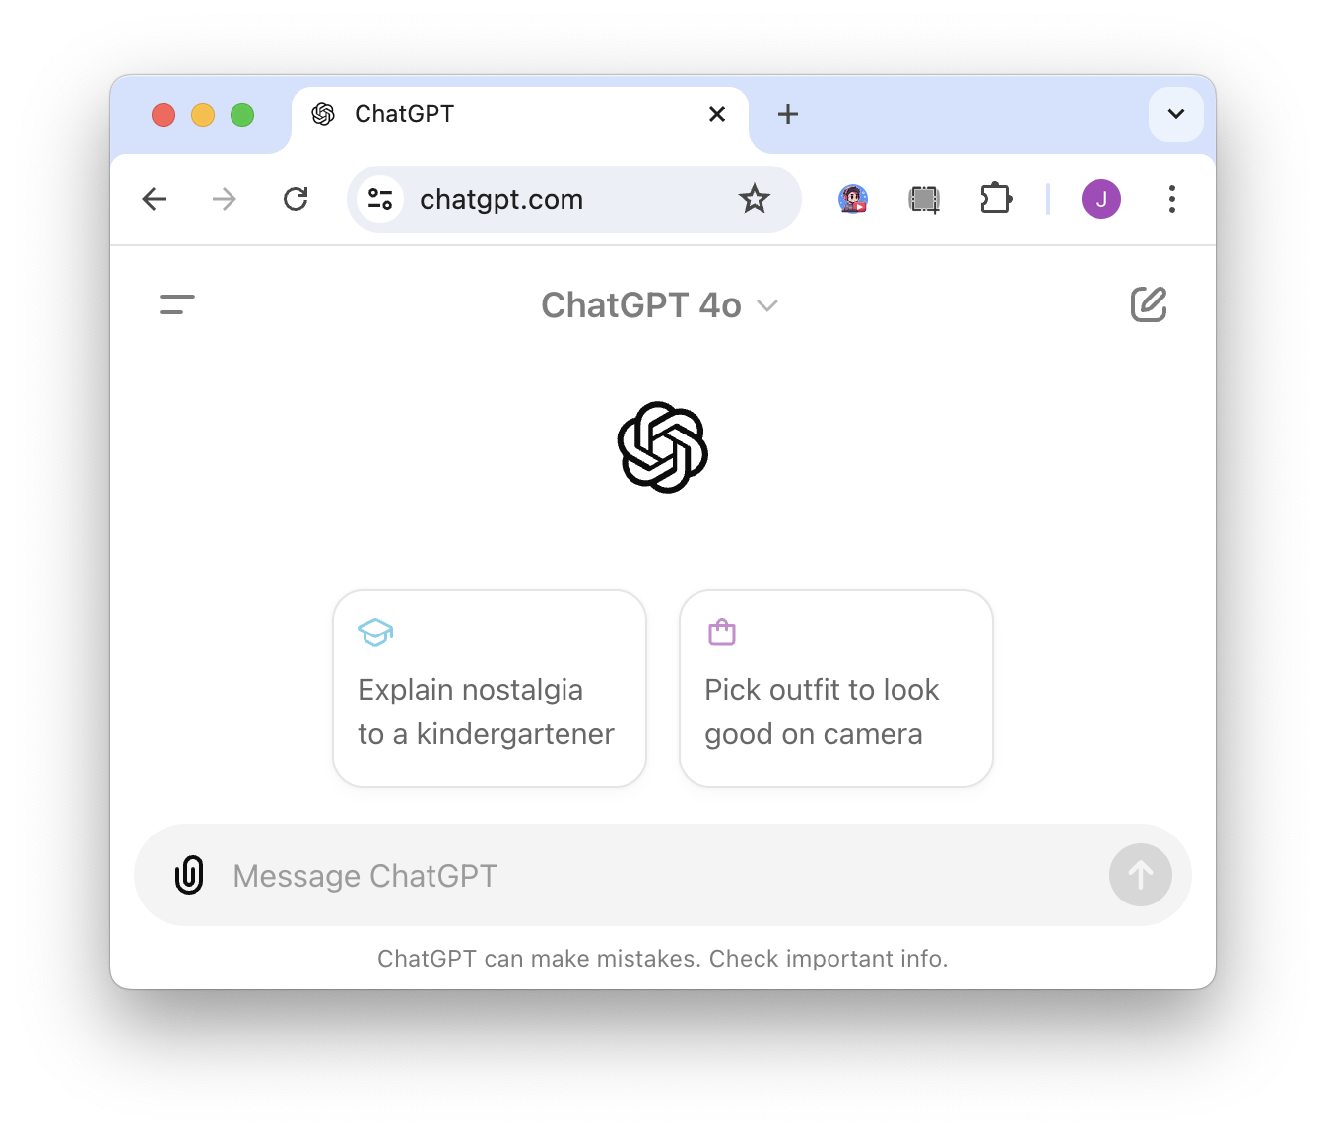



asks question
gives answer

Slide 34
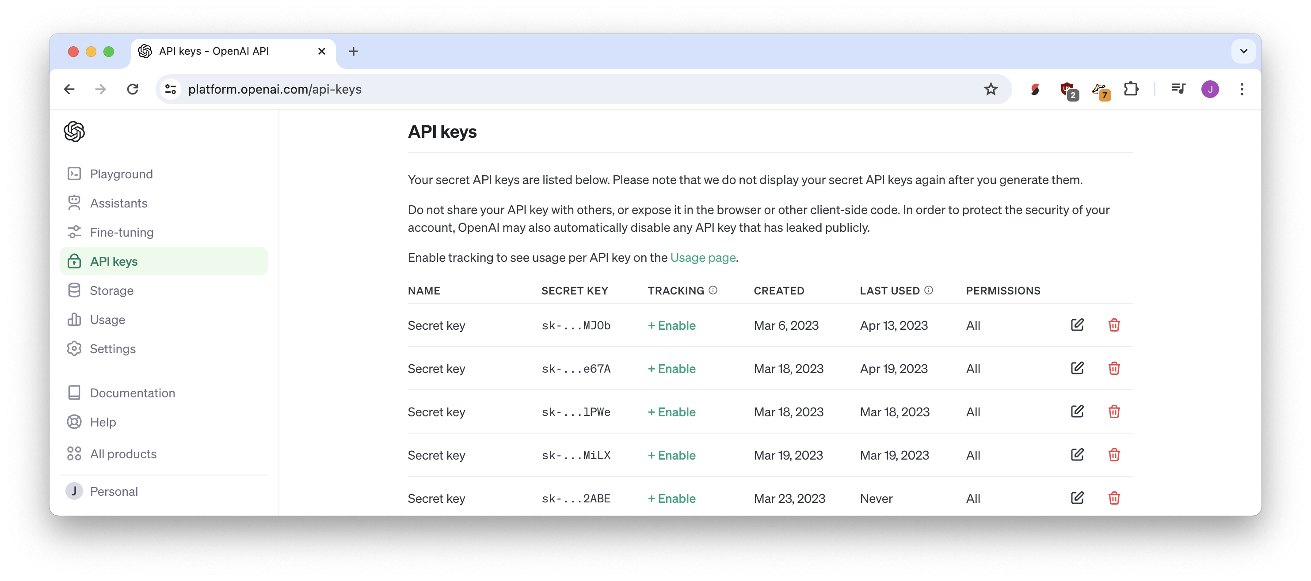
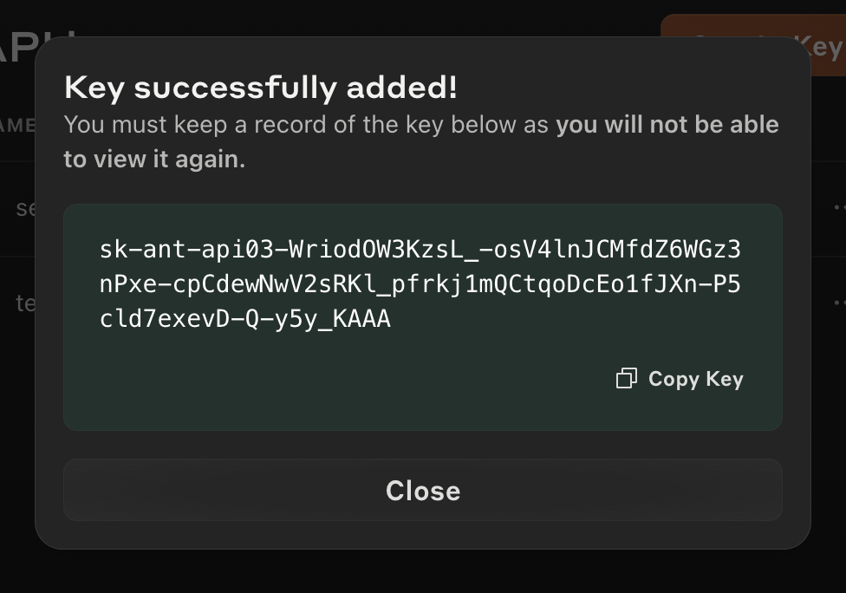
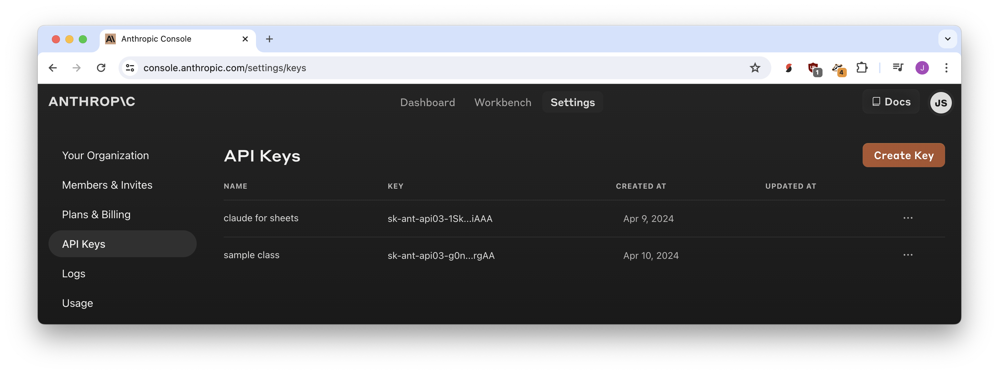
API keys

Slide 35
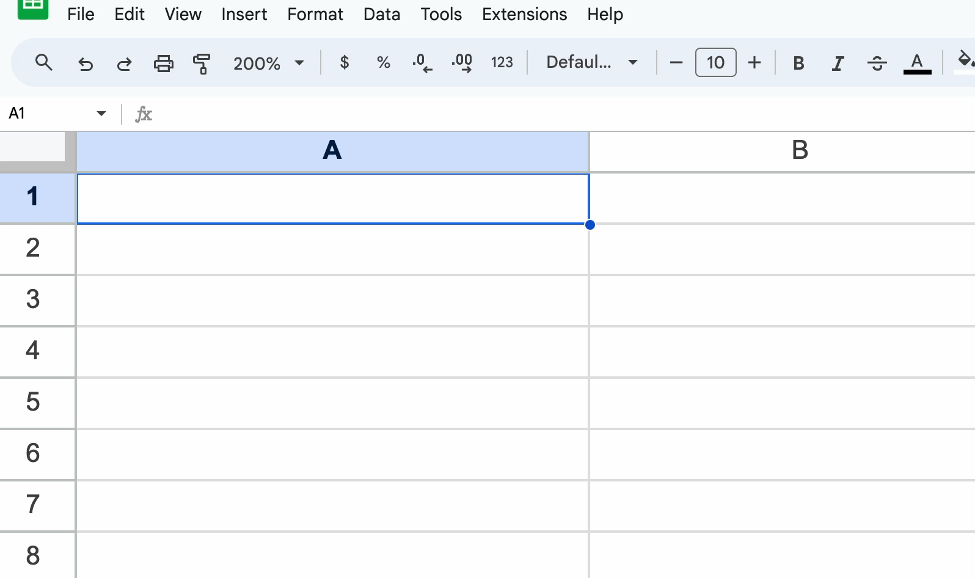

Slide 36
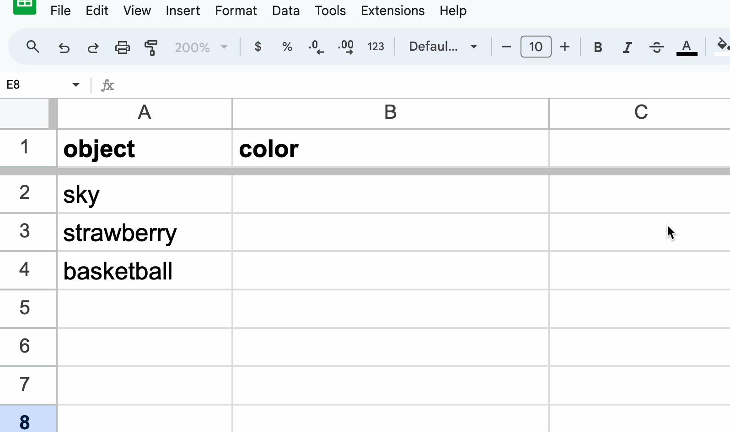

Slide 37
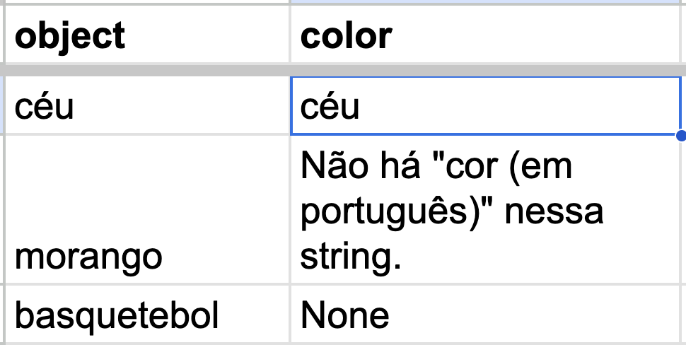



=CLAUDEEXTRACT("cor (em português)”, A2)

Slide 38
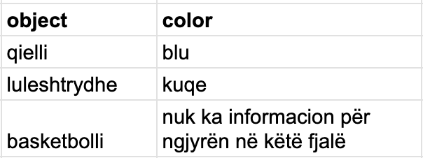
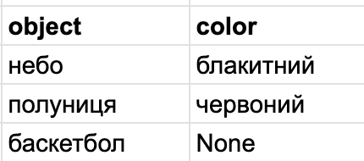


=CLAUDEEXTRACT(“ngjyra (në shqip)”, A2)
=CLAUDEEXTRACT("колір (українською мовою)”, A2)

Slide 39
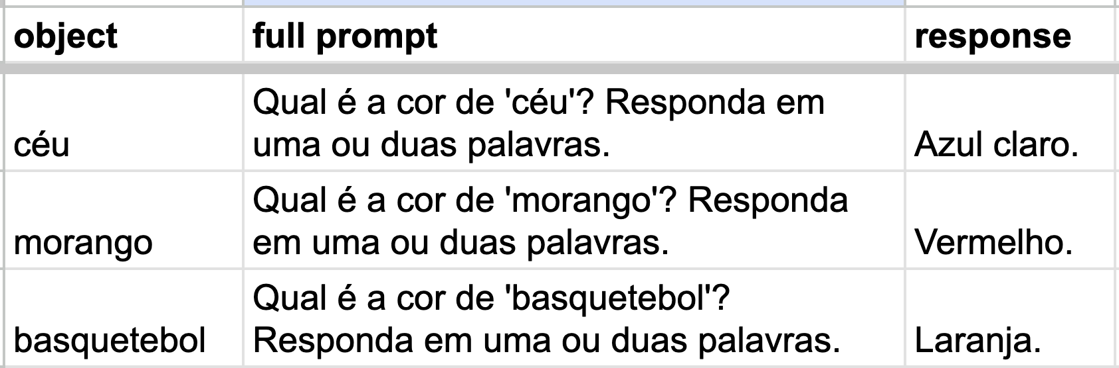



=CONCATENATE("Qual é a cor de ‘", A2, "'? Responda em uma ou duas palavras.”)
=CLAUDE(B2)

Slide 40
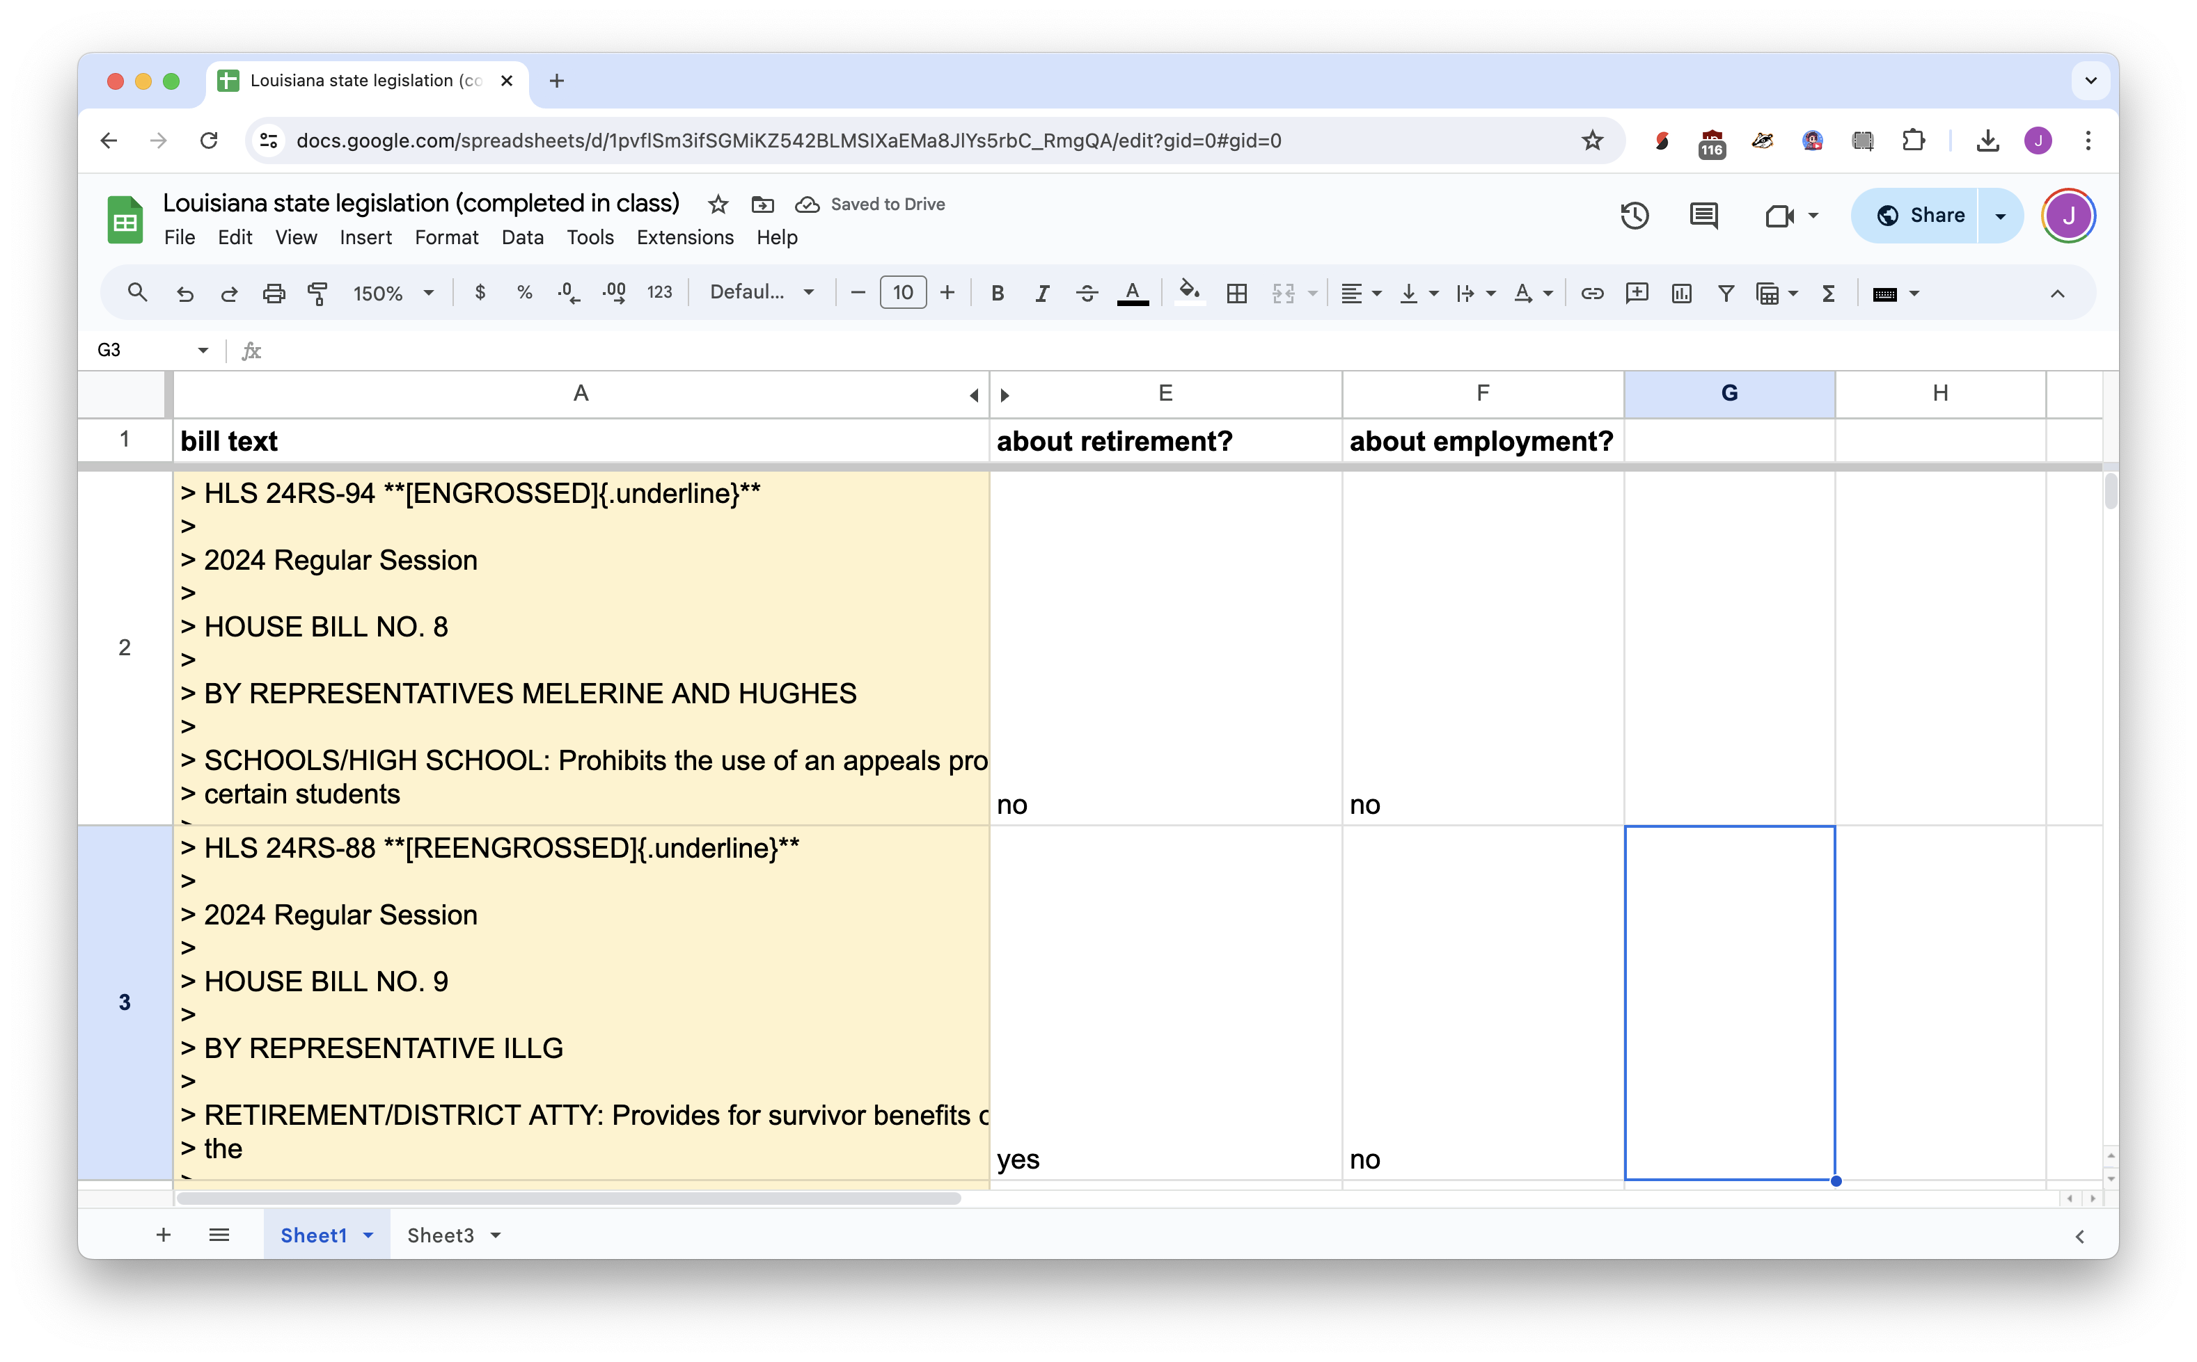



Slide 41





Slide 42
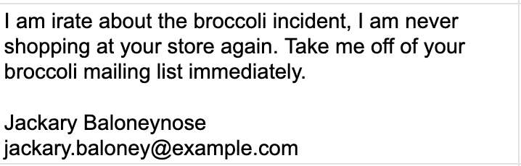

name
email

Slide 43
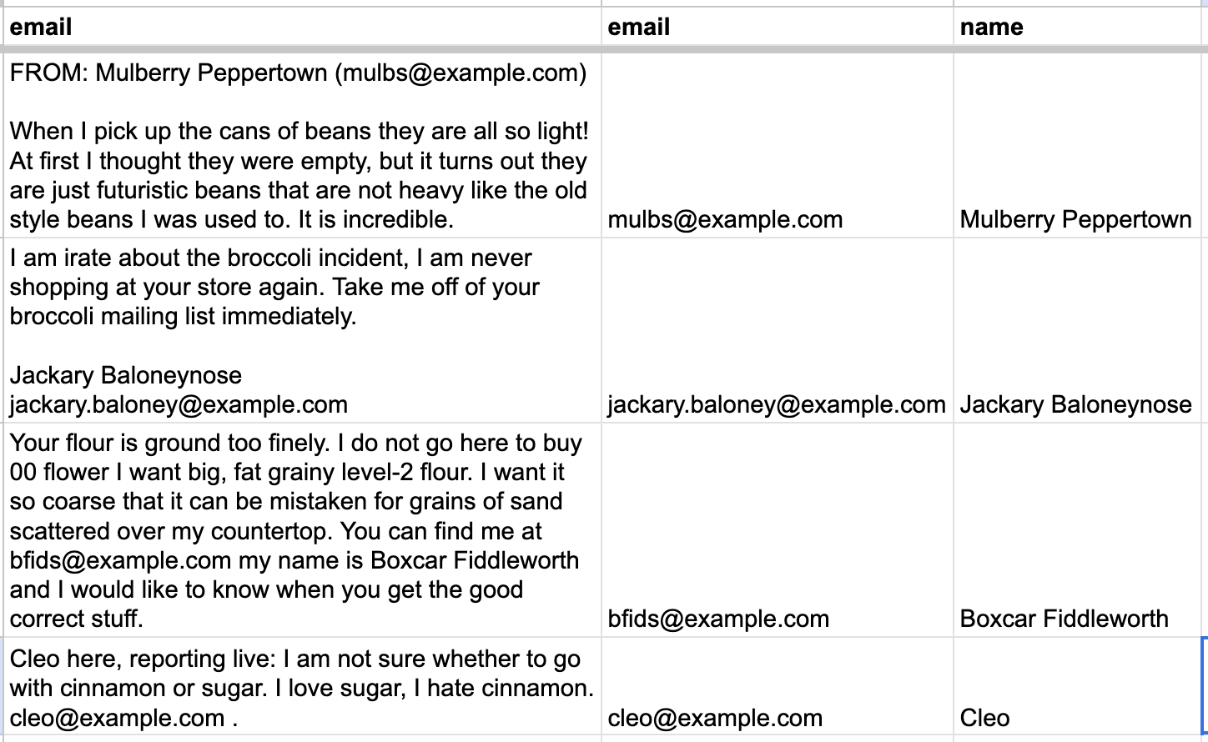


=CLAUDEEXTRACT(….)
“email”
“name”

Slide 44
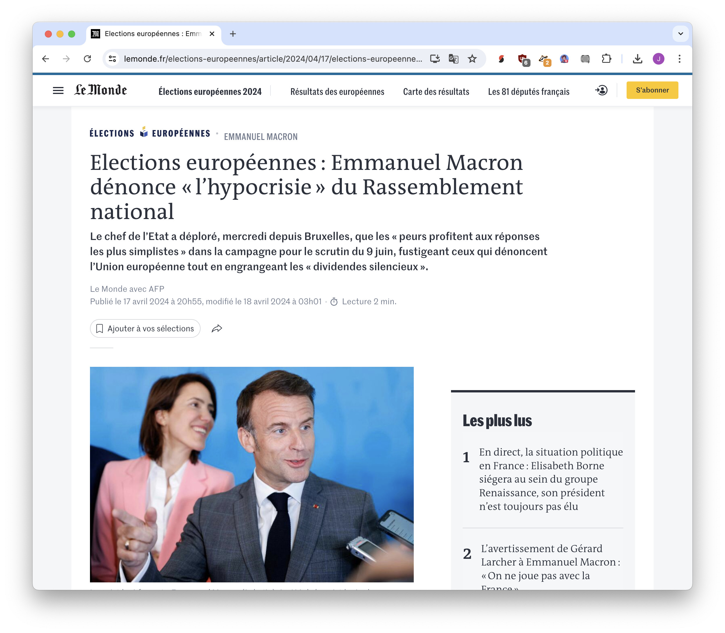


Slide 45
=CLAUDEEXTRACT("people mentioned in the article, with titles if available. One per line.", B5)
=CLAUDEEXTRACT("brief one-sentence summary", B5)
=CLAUDEEXTRACT("English translation", E5)
=CLAUDEEXTRACT("article category, one of politics, sports, international, other", B5)

Slide 46


Slide 47
but yes, you must
spot check results

Slide 48
sometimes you just want
a single answer
from a lot of documents

Slide 50


“answer my question using these 10,000 documents”

Slide 51


Context window

Slide 52
talking to a chatbot about a lot of documents is called
retrieval augmented generation
tech people call it R.A.G.

Slide 53








too much content!
what’s relevant?
“answer my question using these 4 sections”
response from AI

Slide 54
But I’m a little worried the answer is going to be wrong!!!!!!
Did the AI actually find relevant documents?
Did we send too few sections, so it doesn’t have the answer?
Did we send too many sections, confusing the AI?
Did it hallucinate even if it had the right content?

Slide 55


Slide 56




Slide 57
RAG is very irresponsible (especially facing readers!) but it’s also very easy and fun
so let’s do it!

Slide 58


Slide 59



Slide 60


upload documents!

Slide 61


scrape websites!

Slide 62


do a better job than an NYC agency that was paid a lot of money!

Slide 63



Slide 64



Citations aren’t reliable, so be sure to fact-check!

Slide 65



Slide 66


Slide 67




Slide 68



verify, verify, verify

Slide 69



Slide 70
and finally, time for
transcription
because you hate typing out your interviews

Slide 71





Slide 72



Slide 73



https://bit.ly/birn-whisper

Slide 74





Slide 75



Slide 76







Bias

Slide 77
https://bit.ly/birn-data
Jonathan Soma
Columbia University
js4571@columbia.edu
@dangerscarf
AI for Reporting
tricks for the newsroom

